Slide 1
Presentation to Southern Regional Assembly – Elected Members
12th April, 2024

Slide 2
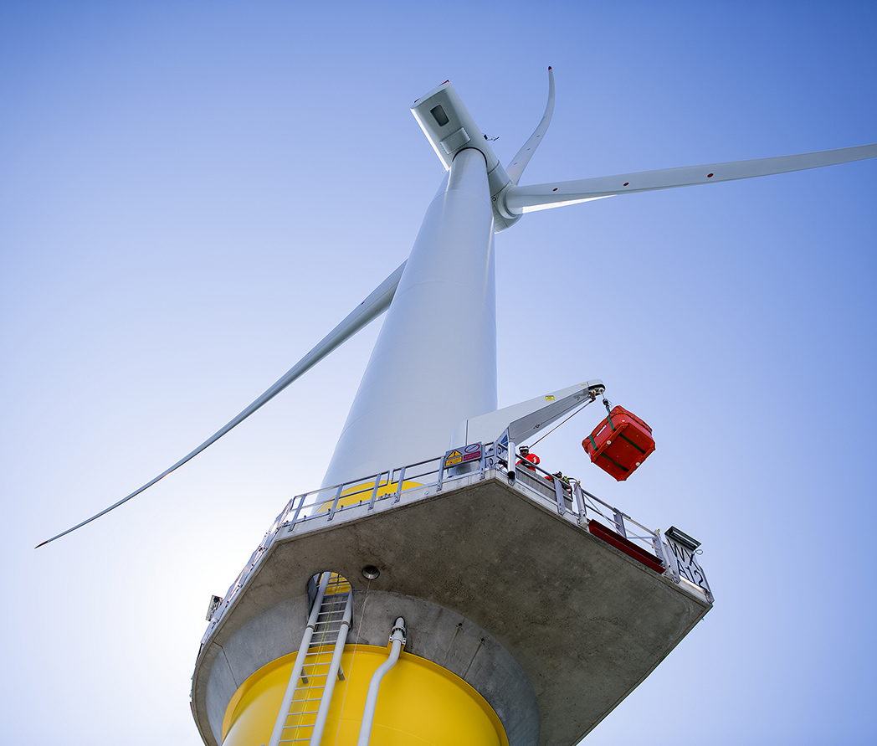
Introductions
Sean Moroney, ESB – Offshore Community Liaison Officer
Thomas McHugh, Ørsted – Stakeholder Communications Manager
Keith O’Sullivan, ESB – Green Energy @ Cork Project Director

Slide 3

Agenda
      Sean – Welcome & Introductions, and overview of ESB
      Thomas – Overview of Ørsted
      Sean – Offshore Wind in Ireland – Policy developments
      Thomas – UK Energy Clusters
      Keith – Green Energy @ Cork, Green Atlantic @ Moneypoint
      Sean - Key messages

Slide 4
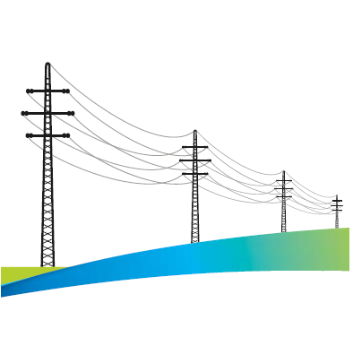




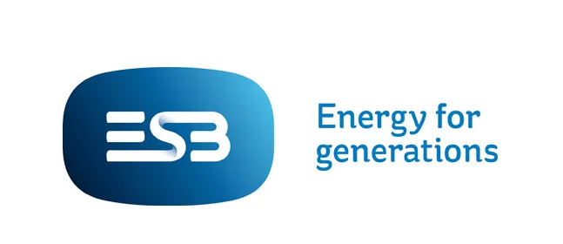

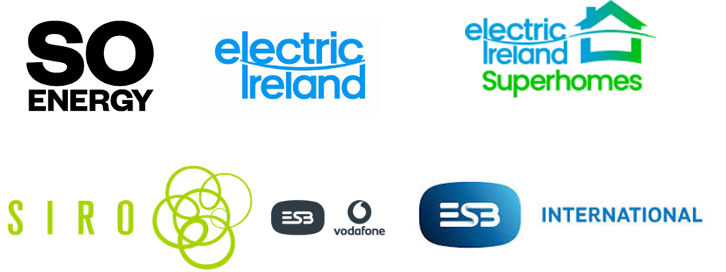
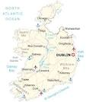
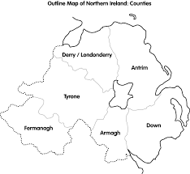
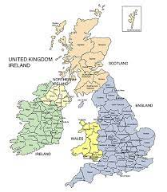
About ESB
REGULATED NETWORKS
GENERATION & TRADING
CUSTOMER SOLUTIONS
Overview
H1 2021 Financial Review
Business Review
Over €1billion invested in infrastructure per year
Over 9,000 employees, with 1,000 added over the past 2 years alone

Slide 5
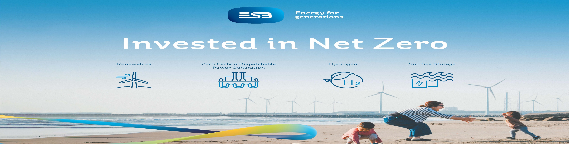
Notes:
Closing Message:
Ireland needs an Integrated Zero Carbon Energy System approach in order to have any chance of meeting Net Zero targets.
ESB’s multi-billion investment in the Shannon Estuary region through its Green Atlantic Programme is a key partner for regional economic development, and offers a radically different future for MidWest powered by green energy .
Leave this image up for any Q&A

Slide 6
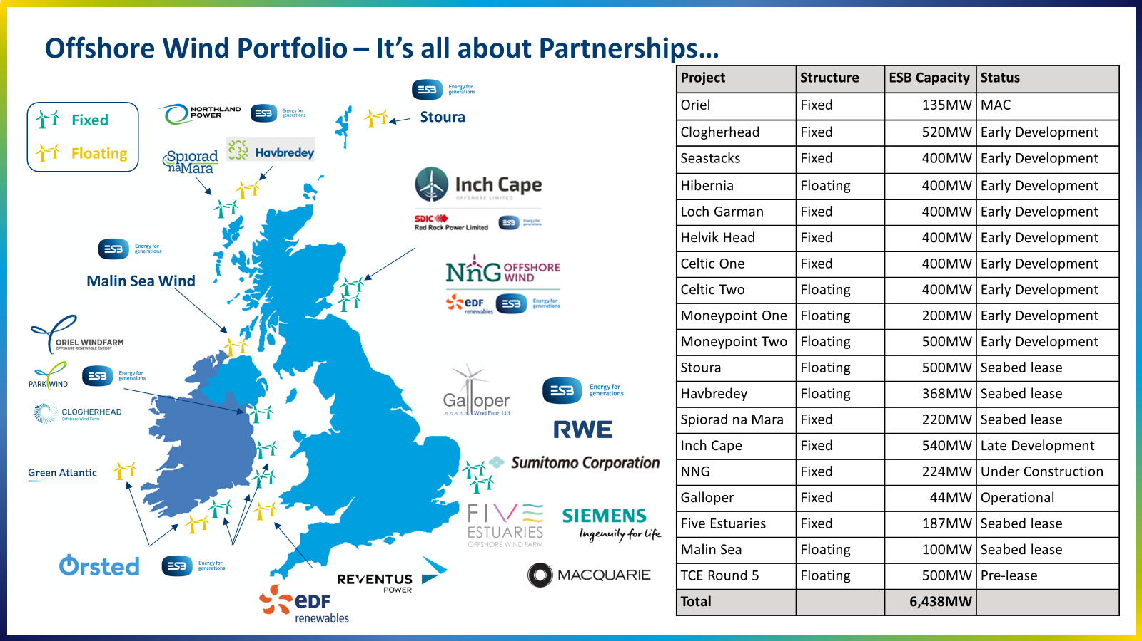

Slide 7


Our vision
Let’s create a world that runs entirely on green energy
7

Slide 8

Transforming the way we power the world
Highlights
Hornsea 2
1.3GW
Located of the coast of England. Ørsted is proud to operate the world’s largest offshore windfarm.
Lisheen 1, 2 & 3
89MW
Spanning the counties of Tipperary, Laois and Kilkenny, this onshore windfarm is our largest in Ireland.
Old 300
430MW
Located in Texas, US. Ørsted has recently commissioned one of the largest solar farms in the USA.
Carnegie Rd
20MW
Located in Liverpool, this was Ørsted’s first venture into Battery Energy Storage Systems (BESS).
Maersk
675MW
Located on the Gulf Coast, this landmark project will power the new Maersk shipping fleet with e-methanol.
Global no. 1
in Offshore
Global top 10
in Onshore
A global leader
in PtX
1st IE solar farm
in Garreenleen
Offshore wind
Onshore wind
Solar PV
Energy storage
PtX
is Power to X,
a term for converting green electricity into other forms of energy storage such as hydrogen
8

Slide 9
Our footprint in UK & I
Sorne Hill 1 & 2
Flughland
Kennoxhead 1
Cloghercor
Kennoxhead 2
Owenreagh1 & 2
Ballykeel
Larbrax
Polquhairn
Isle of man
Ireland
Walney Extension
Westermost Rough
Walney 1 & 2
Barrow
Hornsea 1
West of Duddon Sands
Hornsea 2
Hornsea 3
Garracummer & Mienvee
Burbo Bank
Burbo Bank Extension
Hornsea 4
Booltiagh 1 & 2
Lisheen 1 & 2
Knockawarriga 1 & 2
Ballinagree
Lisheen 3
Burbo Bank Battery Storage
Coom
Smithstown
Carnegie Road
Lincs
Inchincoosh
Kilgarvan
Ballymartin
Renescience Northwich
Race Bank
Sillahertane
Ballinrea Solar Farm
Gneeves
United Kingdom
Sales of energy
Activities
Status
Offshore wind
Bio plant
In operation
Gunfleet Sands 1 & 2
Onshore wind
Sales of energy
Under construction
Gunfleet Sands 3
Storage
Solar
Under development
London Array 1

Slide 10

Republic of Ireland & Northern Ireland
Ireland
€700m
400+
360 MW
234K+
Diverse
Invested in the last
2 years
turbines installed
installed capacity
homes powered
(MW equivalent)
wind, solar, P2X
UK
£15bn
13
6.2 GW
7million
Hornsea
Invested in renewable energy infrastructure
Windfarms offshore and 1 onshore
installed capacity
homes powered with pipeline for 5 million more
world’s largest windfarms
2.5 GW to date
Global
€5bn
12+ GW
8,000+
30+
#1
gross investment in 2022 driven by construction
of both wind and solar assets
installed renewable
capacity globally
global employees
years experience
world leader in offshore wind
2
Notes:
360 installed capacity includes Lisheen 3 and Ballykeel (therefore higher than 327MW on website)
234K uses methodology of 1MW powering 650 homes

Slide 11

We power business
What we do at Ørsted
Our team
Europe Heads of:
- Onshore
- Legal
- Finance
- Commercial
- New Markets
Green energy trading
Our power market team trades over 2 TWh of power in the Irish market.
Corporate Power Purchase Agreements
Headquartered in Denmark, Ørsted employs over 8,000 people globally.
The Ireland team’s home is in Cork. From here we will drive growth through organic and commercial opportunities.
From Cork, our team spans
the functions of:
Development
Operation & Maintenance
Commercial
Market Trading
QHSE
Legal
Finance
People & Development
Public Affairs & Communication
Project Delivery
100+
people work in our growing Cork office

Slide 12
Offshore Wind in Ireland – Policy Developments

Slide 13
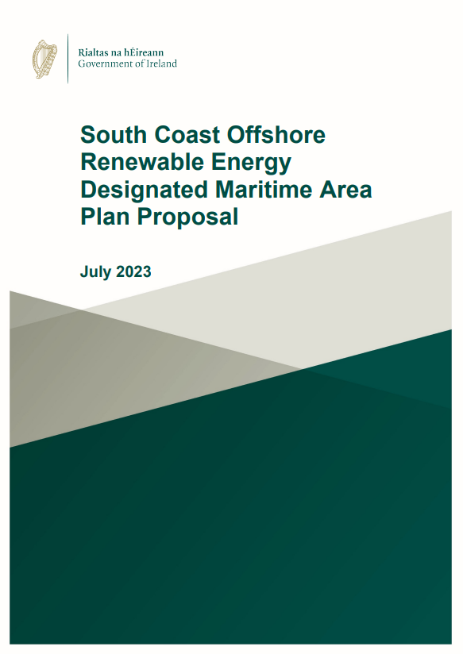
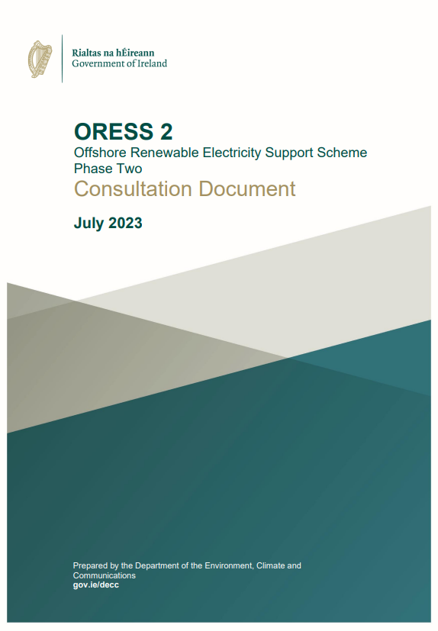
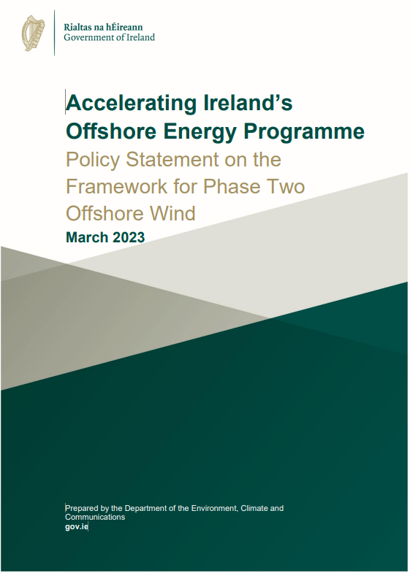
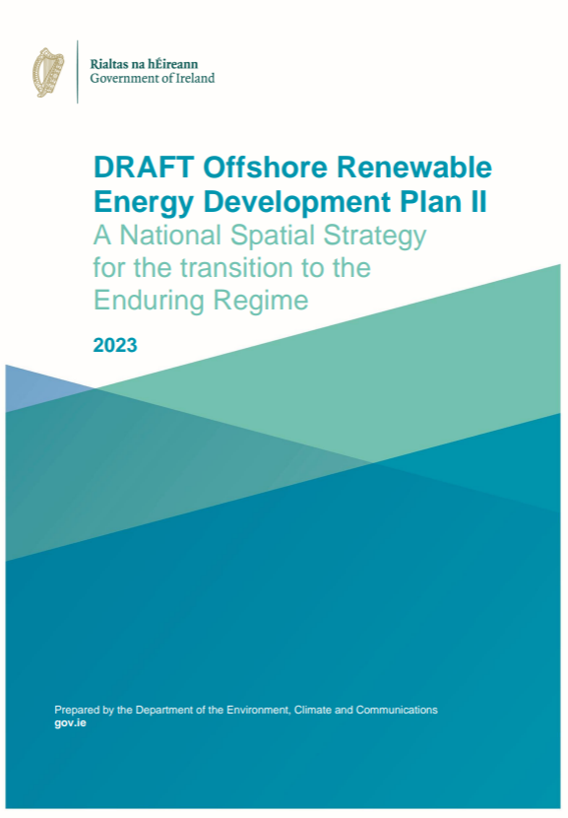
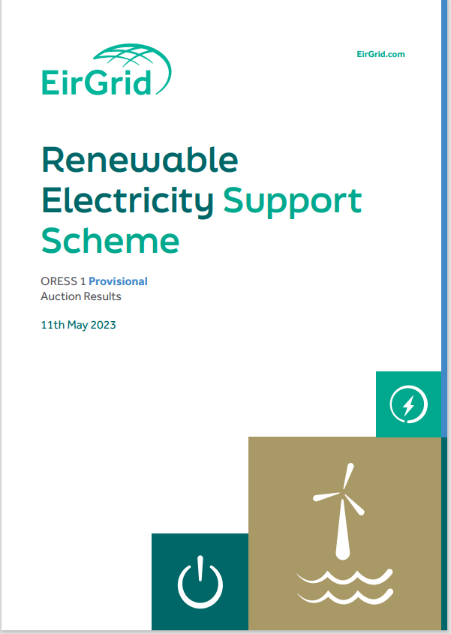
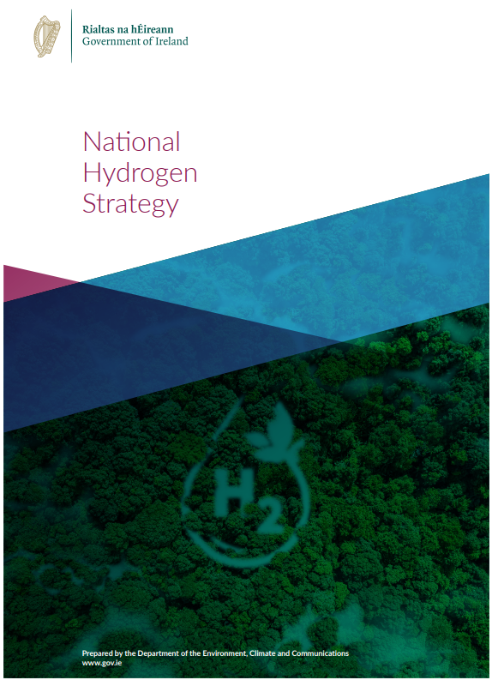
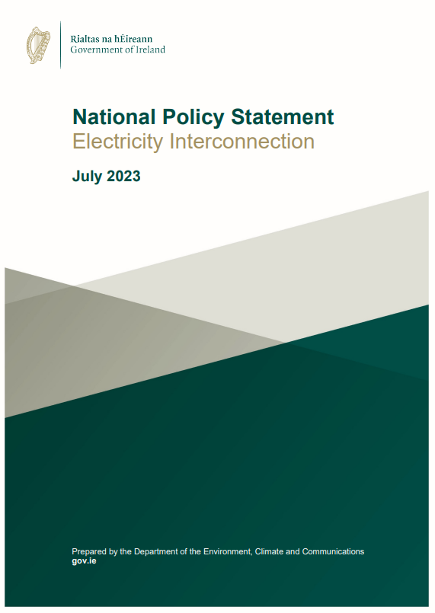
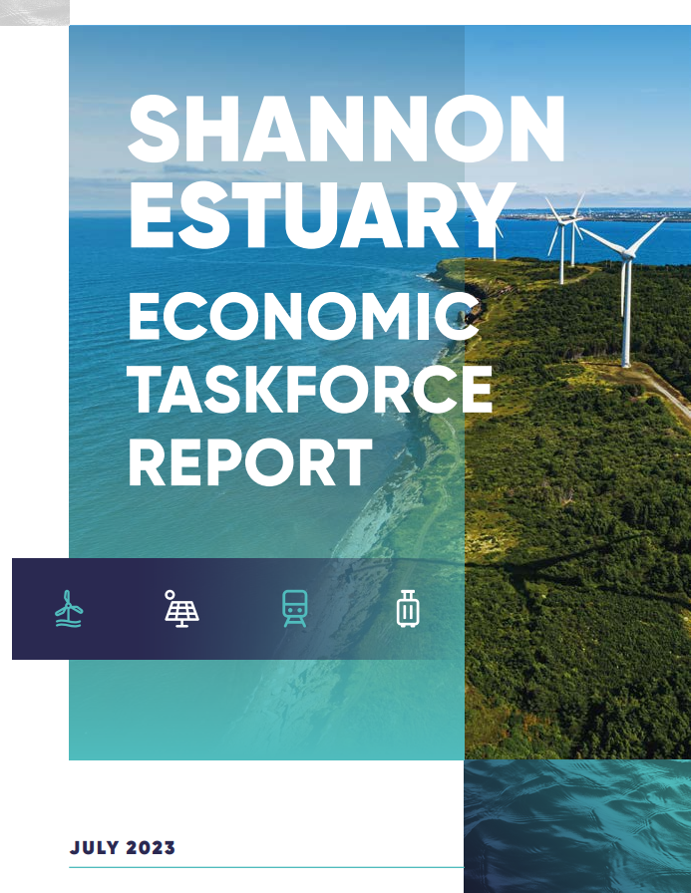
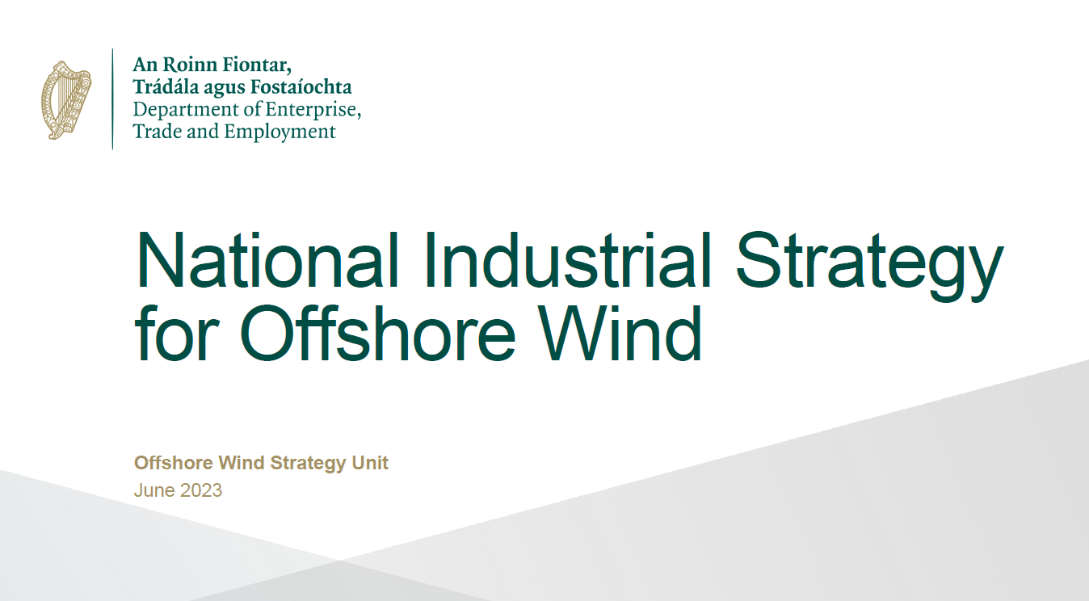
Recent Policy Developments….

Slide 14
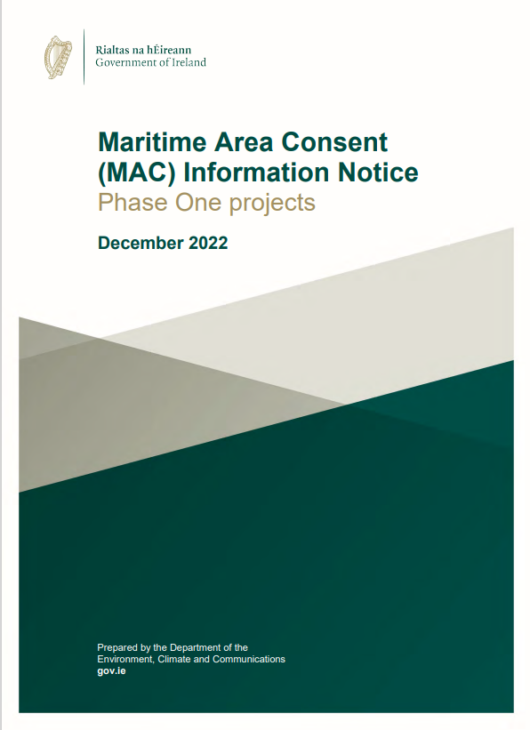
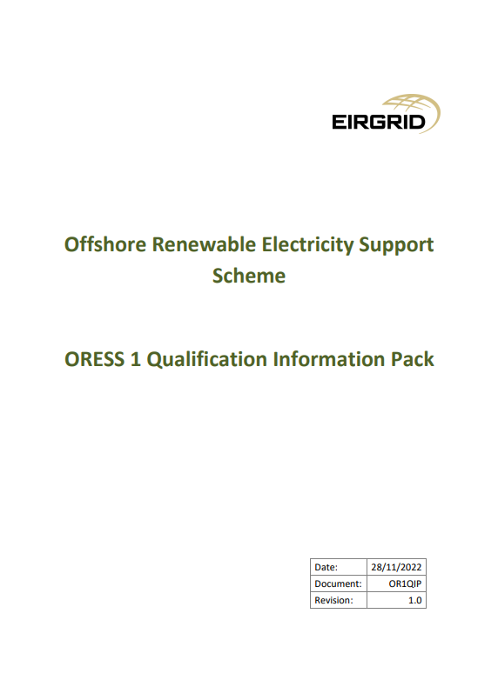
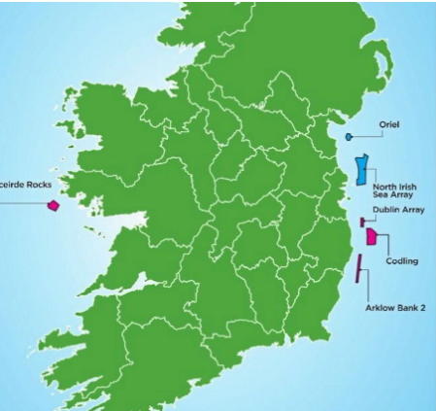
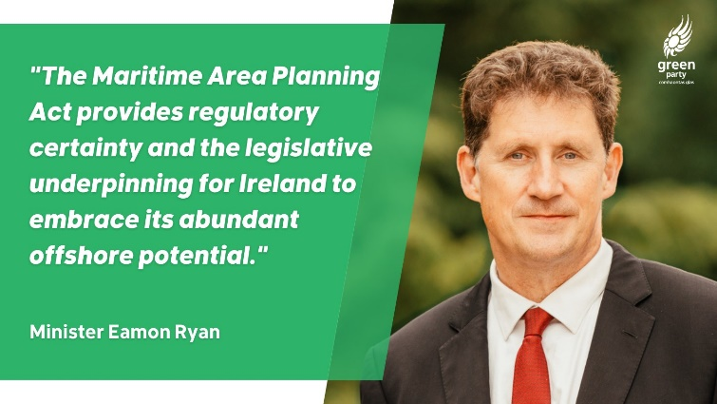
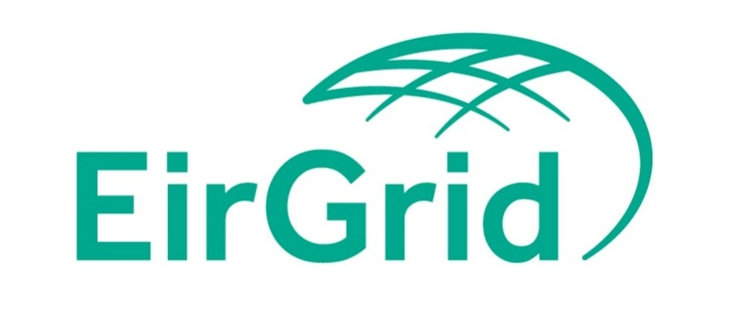
Phase 1 Projects – The Story So Far
May 2020
Sept 2022
Dec 2022
June 2023
Dec 2021
DECC Minister identifies 7 no. Relevant Projects
Maritime Area Planning Act enacted by Government
Eirgrid awards Grid Connection Assessments to Relevant Projects
Minister awards Maritime Area Consents to Relevant Projects
Contracts are awarded to 4 no. projects in ORESS 1

Slide 15
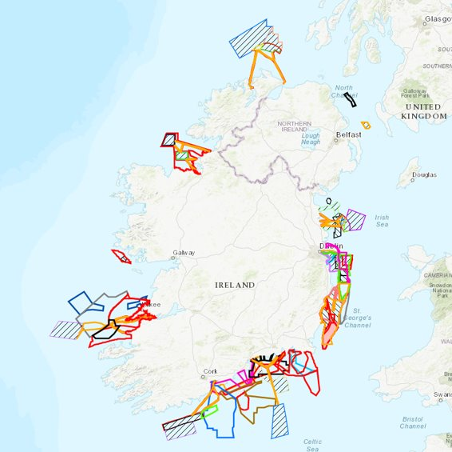
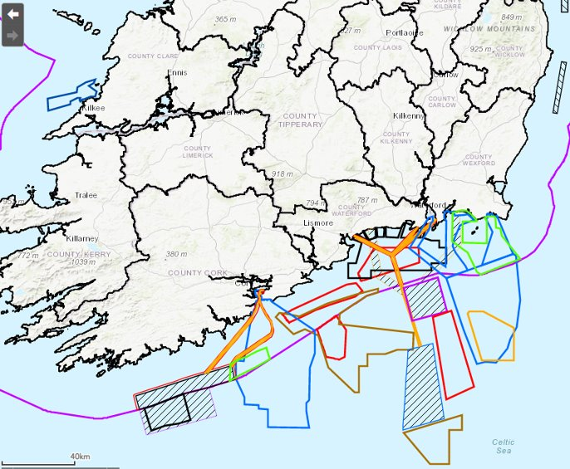
From this….

Slide 16
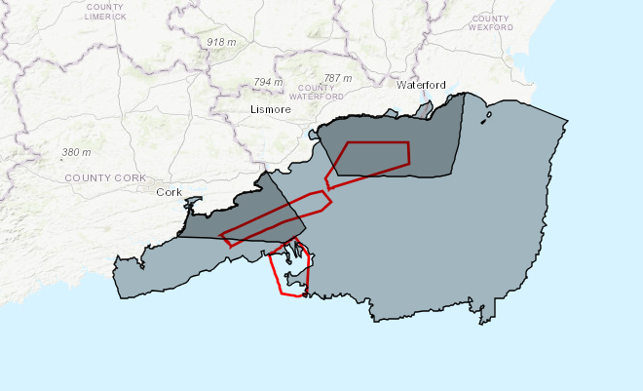
….to South Coast Offshore Renewable Energy Designated Marine Area Plan
EirGrid Areas of Search for offshore nodes
  DMAP proposal area identified based on:
    High Water Mark to 80m depth contour and/or the edge of the EEZ
    Western boundary – military danger/restricted area defined by IAA
    Eastern boundary demarcation between Irish Celtic Sea and Irish Sea, classified by International Hydrographic Office.
  Subsets of this DMAP area will be identified for upcoming auction
  Details of this area(s) will be included in final ORESS 2.1 T&C’s, to be published in Q2 2024, contingent on completion of the DMAP establishment process, including Oireachtas approval
  Further deployment will take place within this DMAP area over the next decade, along with potential further DMAPs for other uses
Helvick Head
Celtic One
Celtic Two
Draft DMAP

Slide 17
Energy Clusters

Slide 18
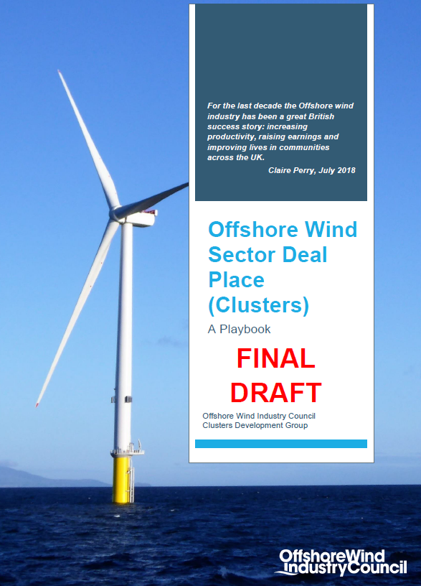
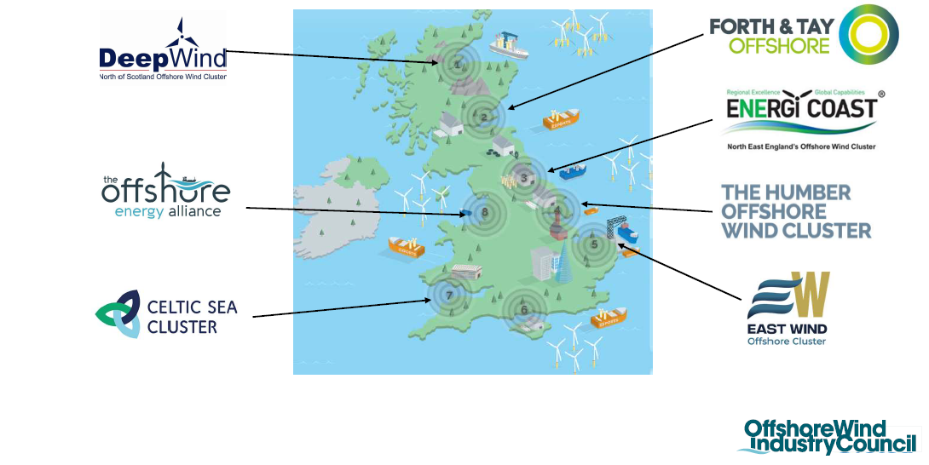
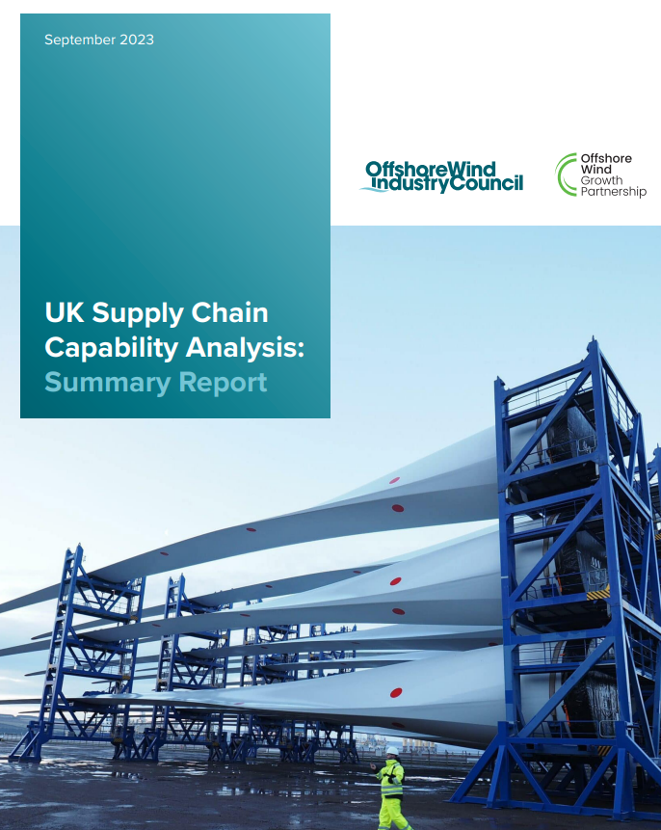
UK Cluster Case Study

Slide 19
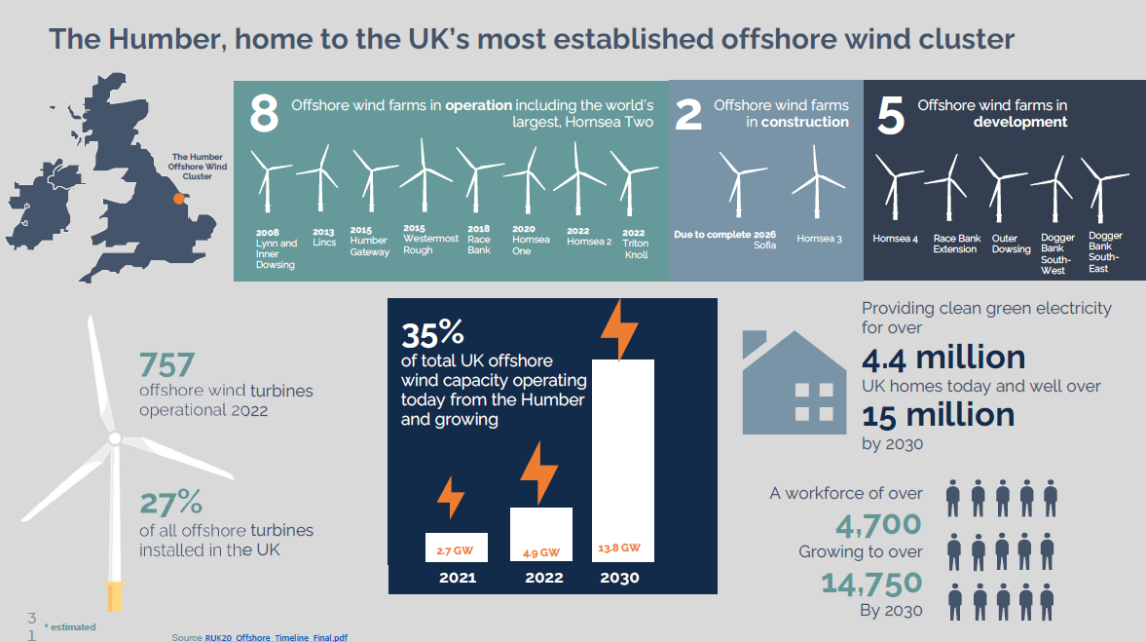
Humber Region Cluster Case Study
Enablers
Anchor offshore renewable energy investment
Regionally led strategy supporting growth
Funding and incentives for development
Industry led collaboration
Education & training
Sustained pipeline

Slide 20
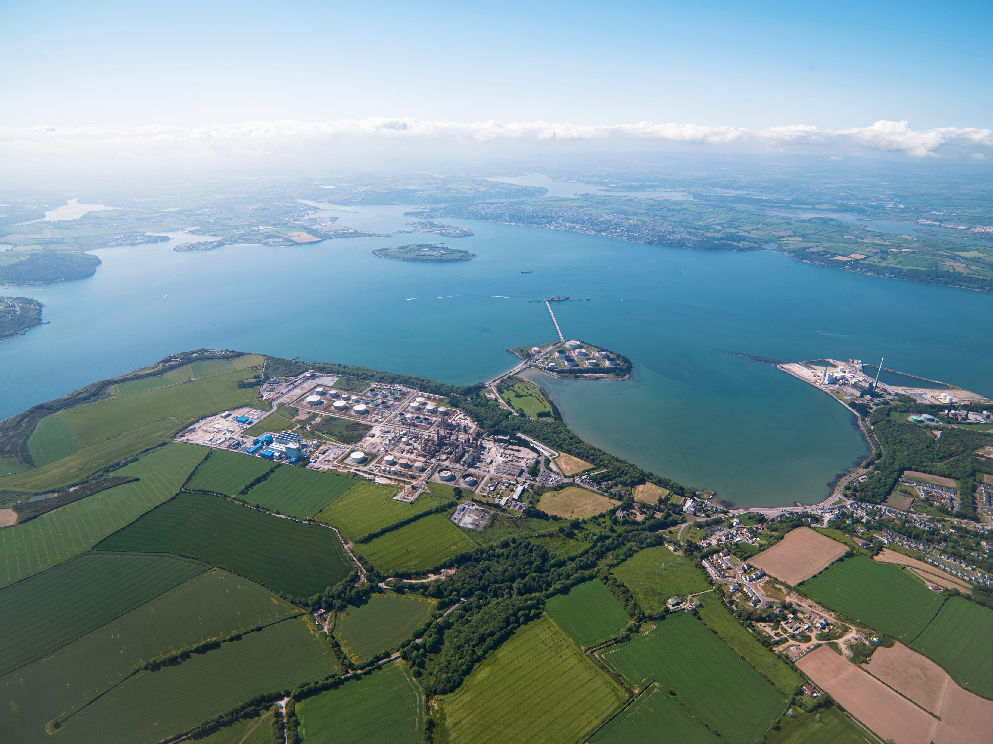
ESB Green Energy @ Cork, ESB Green Atlantic @ Moneypoint
ESB Green Energy @ Cork is a regional clean energy cluster that uses offshore wind energy to produce green hydrogen and zero-carbon electricity.
ESB Green Atlantic @ Moneypoint is a proposal for similar at Moneypoint, Co. Clare

Slide 21
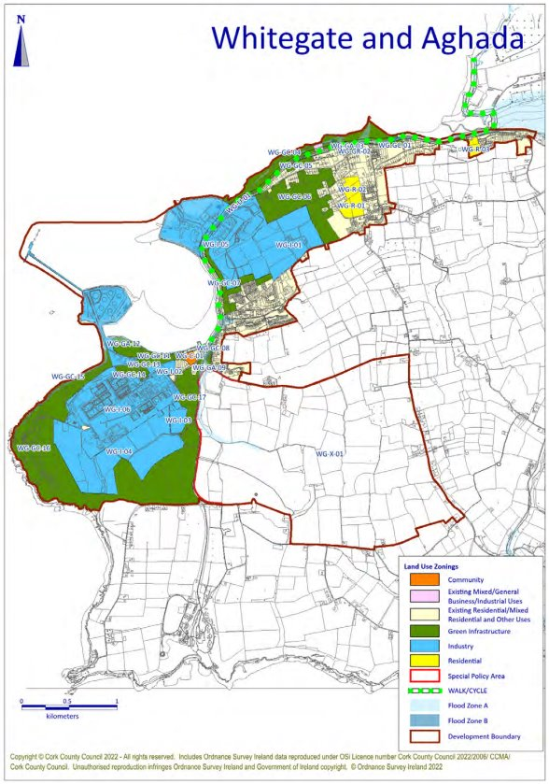
Cork County Development Plan 2022 - 2028
Whitegate and Aghada – “Ireland’s Energy Park”
Strategic Employment Location
Designated Green Energy Park and Nationally Important Role
Designated Cork “Harbour Area” of the County, specifically East Cork Growth Corridor
Location in the County Metropolitan Cork Strategic Planning Area
Proximity to Key Growth Areas and Urban Expansion Areas (Midleton)

Slide 22
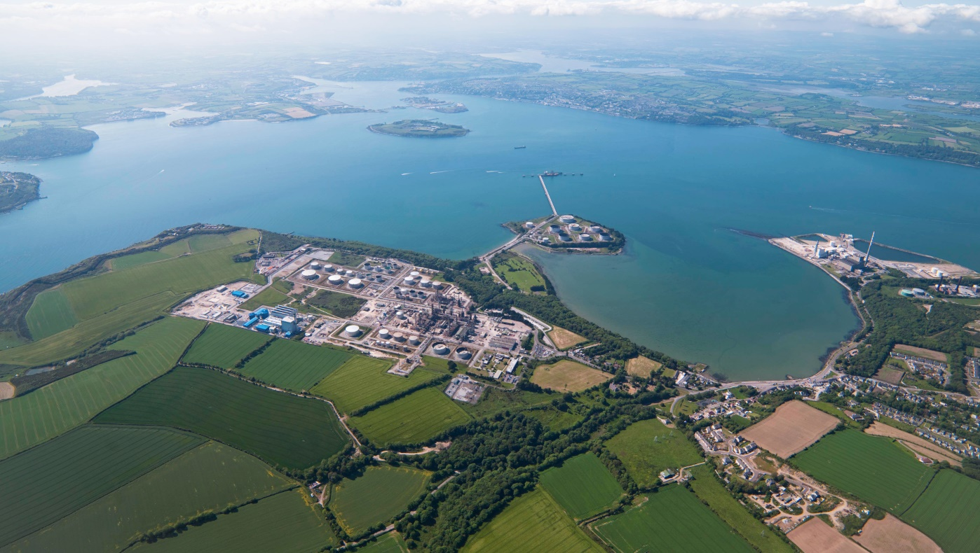





Green Energy @ Cork integrating with a regional vision
E-fuels, biofuel and Ammonia production from Green H₂ @Irving Oil Refinery Whitegate
Ammonia and/or H₂ fueled generation @Whitegate Power
Battery Energy Storage
H₂ fueled generation @Aghada
Subsea Electricity Cables bringing
Offshore Wind to Energy Park
Green H₂ Production and E-fuels Pilot Production @Aghada
Hydrogen Pipeline connecting Kinsale
Gas Field storage and Whitegate
Ireland's First Gas transmission line repurposed for H₂ Pipeline - connecting producers and consumers
H₂ Supply to Cork Renewable Transport Hub & Industrial Off-takers
H₂ Stored @Project KESTREL

Slide 23






Green Energy @ Cork
Decarbonised Electricity
Regeneration of Aghada
Develop and connect renewables to decarbonize the electricity system by 2040
Construct new electricity generation infrastructure at Aghada to support a reliable low-carbon electricity system.
Net Zero by 2040
Energy Parks
Early Hydrogen Projects
Develop plans for an Energy Park where Large Energy Users benefit from the availability of Renewable electricity and Green H2.
Innovate and lead with early Hydrogen demonstration projects. Collaborate with partners to develop a Green H2 industry
Celtic Hydrogen Cluster
Hydrogen at Scale – Energy Storage Solutions
Collaborate with local industry to develop an Industrial Cluster in Cork based on Green Renewable Energy
Develop options for the storage of de-carbonised fuels to support the variability of renewables.

Slide 24
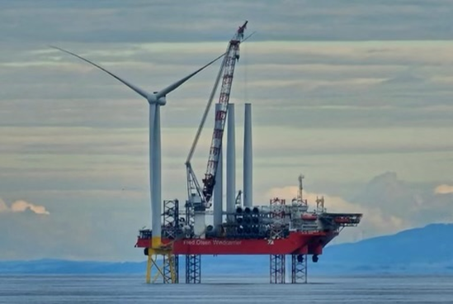
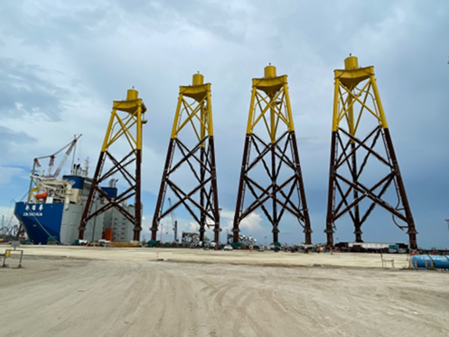
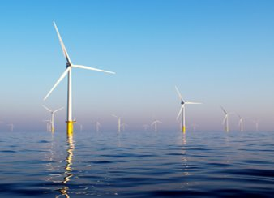
Offshore Wind Key Messages
Offshore wind has the potential to bring green renewable energy to regions, as well as sustainable jobs and economic growth.
Large Energy Users and FDI decarbonisation targets driving greater demand for cleaner energy, Ireland southern region needs to respond.
The southern region has the key ingredients to capitalize on the OSW opportunity.
Support to port development, infrastructure and OSW industrial strategy in the region is vital.
Industry needs clarity on the timelines Future Framework, route to market & subsequent auctions.
Commencement of the MAC process for Future Framework in 2025 would give great confidence to the market and develop the supply chain.

Slide 25
Thank you

