Slide 1
Dr. Karl Murphy EU Affairs Officer, EMRA Urban Contact Point (UCP) for EUI in Ireland National URBACT Point (NUP) for Ireland kmurphy@emra.ie Southern Regional Assembly, Waterford, 16th February 2024

Slide 2
EMRA appointment
EMRA was recently appointed Urban Contact Point (UCP) for the European Urban Initiative (EUI), following nomination by DHLGH
This follows our recent re-appointment as National URBACT Point (NUP) through to 2027; first appointed in 2018
The Contact Point roles help us to work nationally, with all local authorities across the three regions to best offer a menu of SUD options for our towns and cities
Notes:
Visit EUI website at: https://www.urban-initiative.eu/

Slide 3
Background
Origins: during the period 2014-2020, €115 billion from Cohesion policy funds were invested in cities, with €17bn of this managed directly and implemented locally by urban authorities through almost 1,000 sustainable urban development strategies.
Alongside these, the Urban Innovative Actions (UIA) initiative provided direct support for cities to experiment with innovative solutions.
The Urban Development Network (UDN) was configured to support the communication and the exchange of information between "article 7 cities" (cities committed to implementing sustainable urban development), the UIA cities and the European Commission.
During this period, the URBACT III programme was helping cities too.

Slide 4
Background
For the period 2021-27, objective 5 of the European Cohesion Policy "Europe closer to citizen" seeks to enhance Member States' commitment to integrated territorial development and to foster sustainable urban development.
In light of this, the EUI seeks to build on all the above legacy by continuing to support the Urban Agenda for the EU, working closely with the now URBACT IV programme, and by consolidating the UIA and UDN into one initiative, giving concrete support to cities; fostering city-led innovation, the sharing of urban knowledge, practice, and to further build capacity.
The European Urban Initiative (EUI) is funded by the European Union, with a total ERDF budget of €450m for 2021-27.

Slide 5
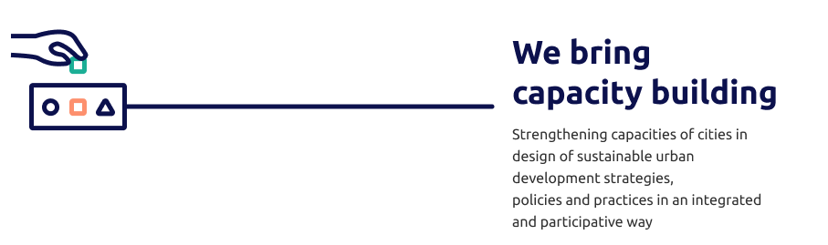

Slide 6
Innovative Actions

Slide 7
Innovative
Actions
specific
objectives
To identify and support the testing of transferable and scalable innovative solutions to address issues relating to sustainable urban development at Union level
To collect and share results from experimentations and support transfer activities, in view of fostering innovation capacities and knowledge building for all EU urban areas and mainstreaming innovative solutions in sustainable urban development

Slide 8
EUI SUPPORTS PROJECTS, which are:
INNOVATIVE
not implemented previously in EU
PARTICIPATORY
MEASURABLE
SUSTAINABLE AND SCALABLE
TRANSFERABLE
Implemented in partnership. Prepared with a leading role for the city as a strategic partnership leader. Planned to achieve the goals of local strategies and policies. In line with the spirit of the principles of good urban governance according to the New Leipzig Charter. Fostering local innovation ecosystem.

Slide 9
1
Financial support: €315m available with up to EUR 5 million ERDF (maximum co-financing rate of 80%)
2
Beneficiaries : urban authorities (associations or groupings of urban authorities) with a total population of more than 50 000 inhabitants
3
Implementation period : 3.5 years
(+ 6 months of Initiation Phase and 3 months for administrative closure of activities)
4
Thematics : each time defined by the European Commission and based on themes identified in the Urban Agenda for the EU;
Call 1 : New European Bauhaus
Call 2 : Greening cities, Sustainable tourism, Harnessing talent in shrinking cities
5
Next Calls :
Call 3 : May 2024. the themes released in March!
Call 4 : Spring 2025
Notes:
Call 1 results: https://www.urban-initiative.eu/calls-proposals/first-call-proposals-innovative-actions/selected-projects

Slide 10
Capacity Building

Slide 11
Capacity Building
Target: EU cities of all sizes
Objective: improve the capacities of cities to design and implement sustainable urban development (SUD) strategies, policies and practices in an integrated and participative way.
www.urban-initiative.eu/capacity-building (webpage)
capacitybuilding@urban-initiative.eu (email address)
Notes:
Targeting urban practitioners & policymakers from EU cities that are interested/involved in SUD

Slide 12
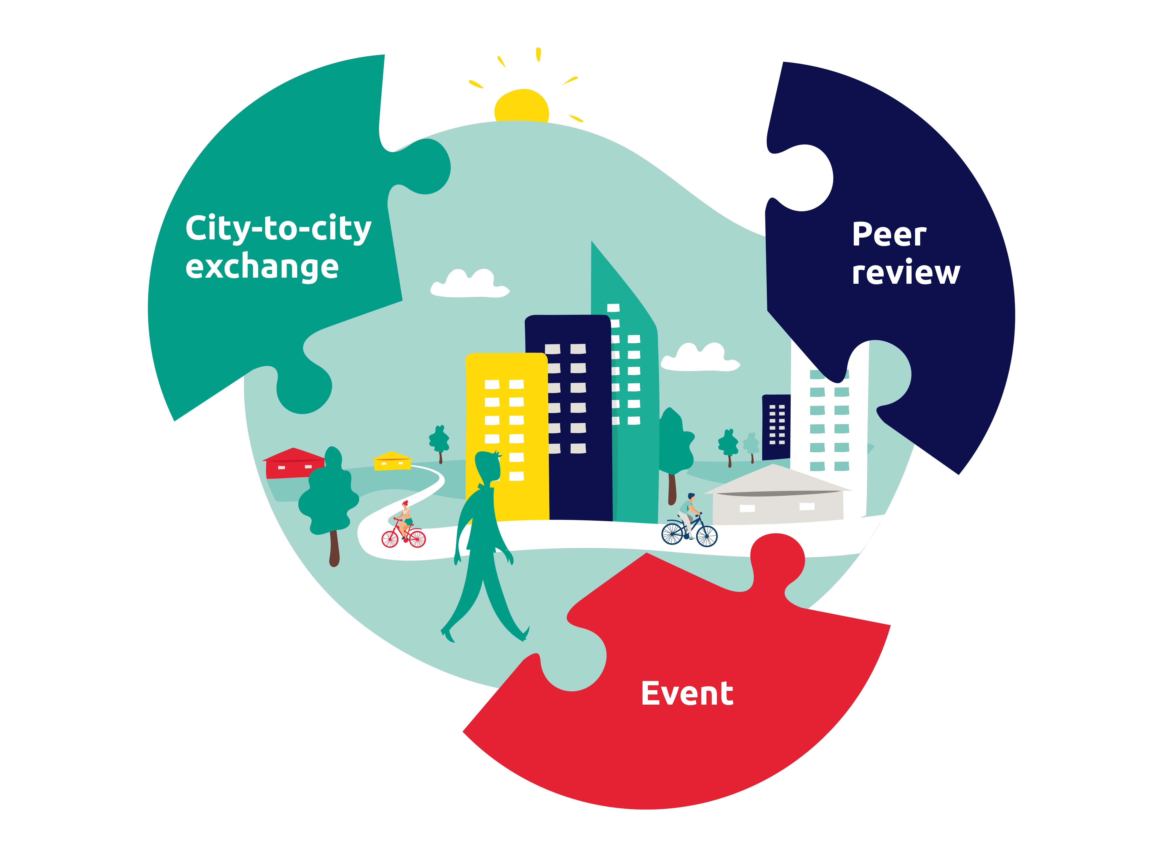
In sum: Innovative Actions & Capacity-building
Innovative Actions
City-to-city exchanges
Peer reviews
Innovative, participatory, measurable, sustainable, transferable and scalable!
€315m available with up to €5m ERDF w/max co financing rate of 80%.
Implementation period is 3.5 years.
Target audience: urban localities w/population of 50k+
New call launched in May 2024 with themes available for this call in March.
Country-specific events:
Delivering high-quality ITIs - Zadar (HR), 24-25 Oct.
Functional Urban Areas - Budapest (HU), 21 Nov.
EU-wide event:
Green transition - Lille (FR), 8-9 Nov.
Brings together an urban authority facing an implementation challenge, and another one or two, who can help tackling this challenge with their expertise and experience.
Target audience: urban and sub-urban localities of all sizes.
Art. 11 and Art. 7 Cities review their SUD strategies and get recommendations from peers during a 2-day event. Experts guide cities during the whole process.
Target audience: urban and sub-urban localities of all sizes.
New call envisaged in q1 and q4, 2024-approx. Feb and Oct
Call now open on a continuous basis.

Slide 13
Eligibility
The applicant local administrative unit (“LAU” - of which Ireland has 166) should be classified as urban or sub-urban (this classification is provided by Eurostat - first informed by census data).
This criterion is important for both Innovative Actions and Capacity Building activities.
A further criterion for Innovative Actions’ projects is a population of 50k+ inhabitants in the urban location applying to the call.
There is some potential for an agglomeration of LAUs to work together to meet that population criterion.

Slide 14
Eligibility
For Innovation Actions:
https://www.urban-initiative.eu/online-guidance-innovative-actions see page 14-15 and section 1.5.1, arrow 2
“Municipality/city councils whose administrative borders include several Local Administrative Units. This is the case for municipalities/city councils in Portugal, Ireland, Greece, Malta and Latvia where the Eurostat definition of Local Administrative Unit does not correspond to municipalities/city councils but to infra-municipal units (parishes) or statistical units (electoral wards). In this case the municipality/city council can be eligible only if it has a total of 50 000 inhabitants and if the majority (at least 51% of the inhabitants) live in Local Administrative Units classified as cities, towns or suburbs according to the degree of urbanisation (code 1 and/or 2 in the Correspondence table – column Degree of Urbanisation)”
https://www.urban-initiative.eu/self-assessment-tool

Slide 15
Knowledge capitalisation

Slide 16
Knowledge capitalisation objectives
Develop the knowledge base to support better design, implementation and mainstreaming of sustainable urban development policies and strategies
Capture, analyse, systematically disseminate and optimise access to operational and thematic knowledge generated within the EUI (e.g. via Portico* and other communication channels)
Provide urban policy makers and practitioners with consolidated knowledge in a format that supports evidence-based policy making and quality programming, as well as the design and implementation of public investments, in particular under Cohesion policy.
Notes:
Visit Portico platform: https://www.urban-initiative.eu/portico

Slide 18
What it is?
The Urban Agenda for the EU represents a multi-level working method, for urban policy and practice, promoting cooperation between Member States, cities, the European Commission, and other stakeholders.
an Informal Intergovernmental Cooperation
working method - multi-stakeholders & multi-level cooperation
cities "at the core"
Notes:
Learn more about Urban Agenda for the EU: https://www.urbanagenda.urban-initiative.eu/urban-agenda-eu

Slide 19
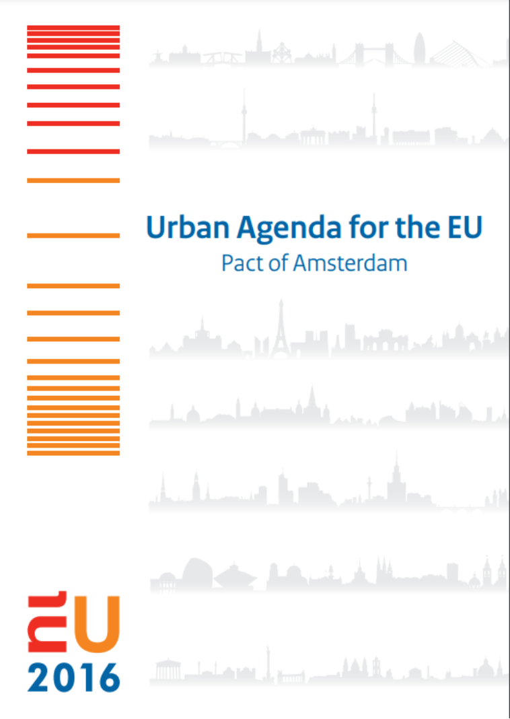
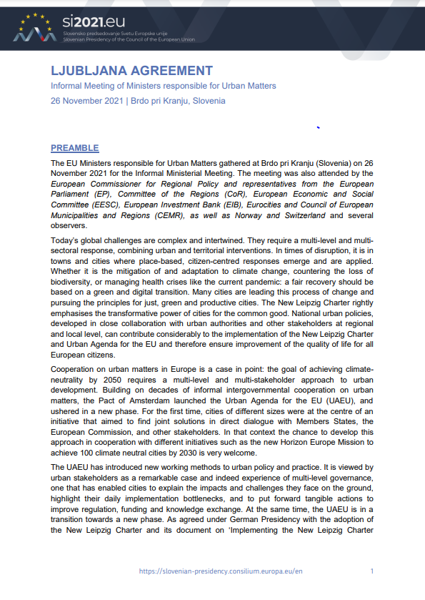
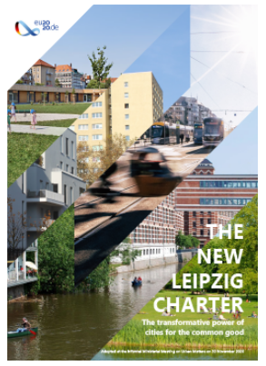

Slide 20
What is the scope?

Slide 21
Partnership composition?
Member states
Umbrella Organisations
Other
Regions
Cities
EU institutions

Slide 22
UAEU Thematic Partnerships
Launched
before 2O22
Culture and
Cultural Heritage
Inclusion of Migrants and Refugees
Public
Procurement
Launched in 2022
Expected in 2023
Sustainable Tourism
Greening Cities
Cities of
Equality
Food
Notes:
18 in total since 2016!

Slide 23
Functions of UCPs
UCP tasks
Facilitate bridging and a two-way communication channel between the EUI and its stakeholders across the European Union.
Raise awareness, reach out, and communicate on EUI and its opportunities, outputs, and results.
Disseminate and share information on available urban knowledge and facilitate the production of it.
Support specific EUI activities.
Act as a key interlocutor to article 7 and article 11 cities and to Managing Authorities and intermediate bodies.
Strengthen national networking.
Facilitate linking between national activities and the Urban Agenda for the EU.

Slide 24
Reaching out and staying in touch
Please follow us on “X”, formerly Twitter: @URBACT_IE
Subscribe to the URBACT Ireland newsletter
Both are the source of communication on all things EUI and URBACT
Reach out anytime on the above slides or any other EUI or URBACT-related matter at kmurphy@emra.ie
A reminder that a current URBACT call for Innovation Transfer Networks is open until March 20th: visit https://urbact.eu/get-involved to learn more and please reach out to me anytime.

Slide 25
Thanks for your attention!!
Any questions?

