Slide 1
Southern Regional Assembly Presentation GPP and CO₂ Performance Ladder in Construction
Rachel Loughrey 8th March 2024

Slide 2
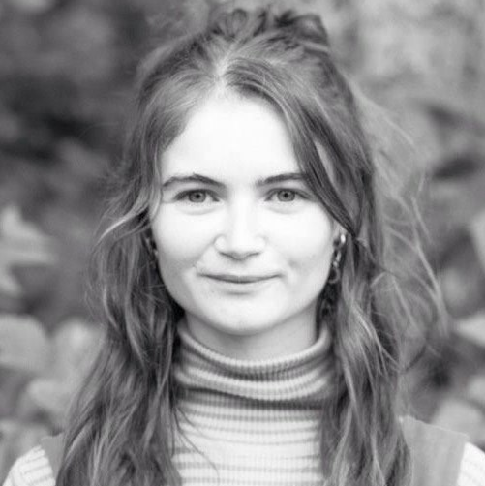
About Us
Rachel Loughrey
Programme Manager and Architect
CO₂Performance Ladder & Construction Materials Exchange (CMEx)
Notes:
Here is an alternative implementation of the IGBC design device, intended for use on slides with less content.

Slide 3
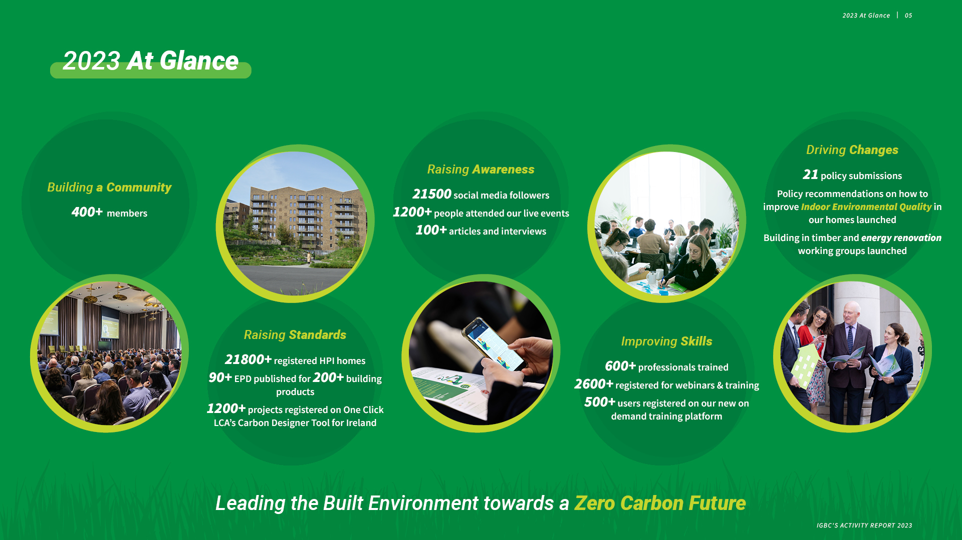
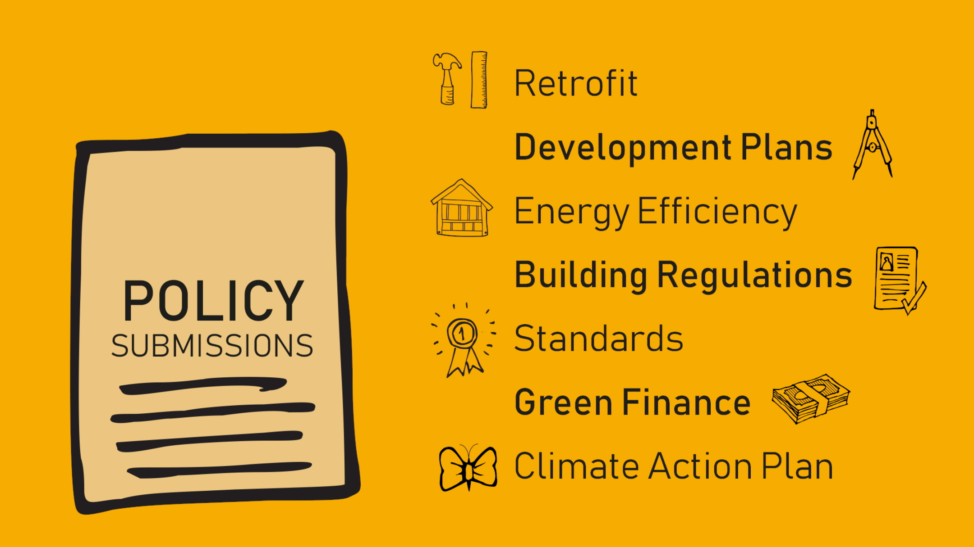
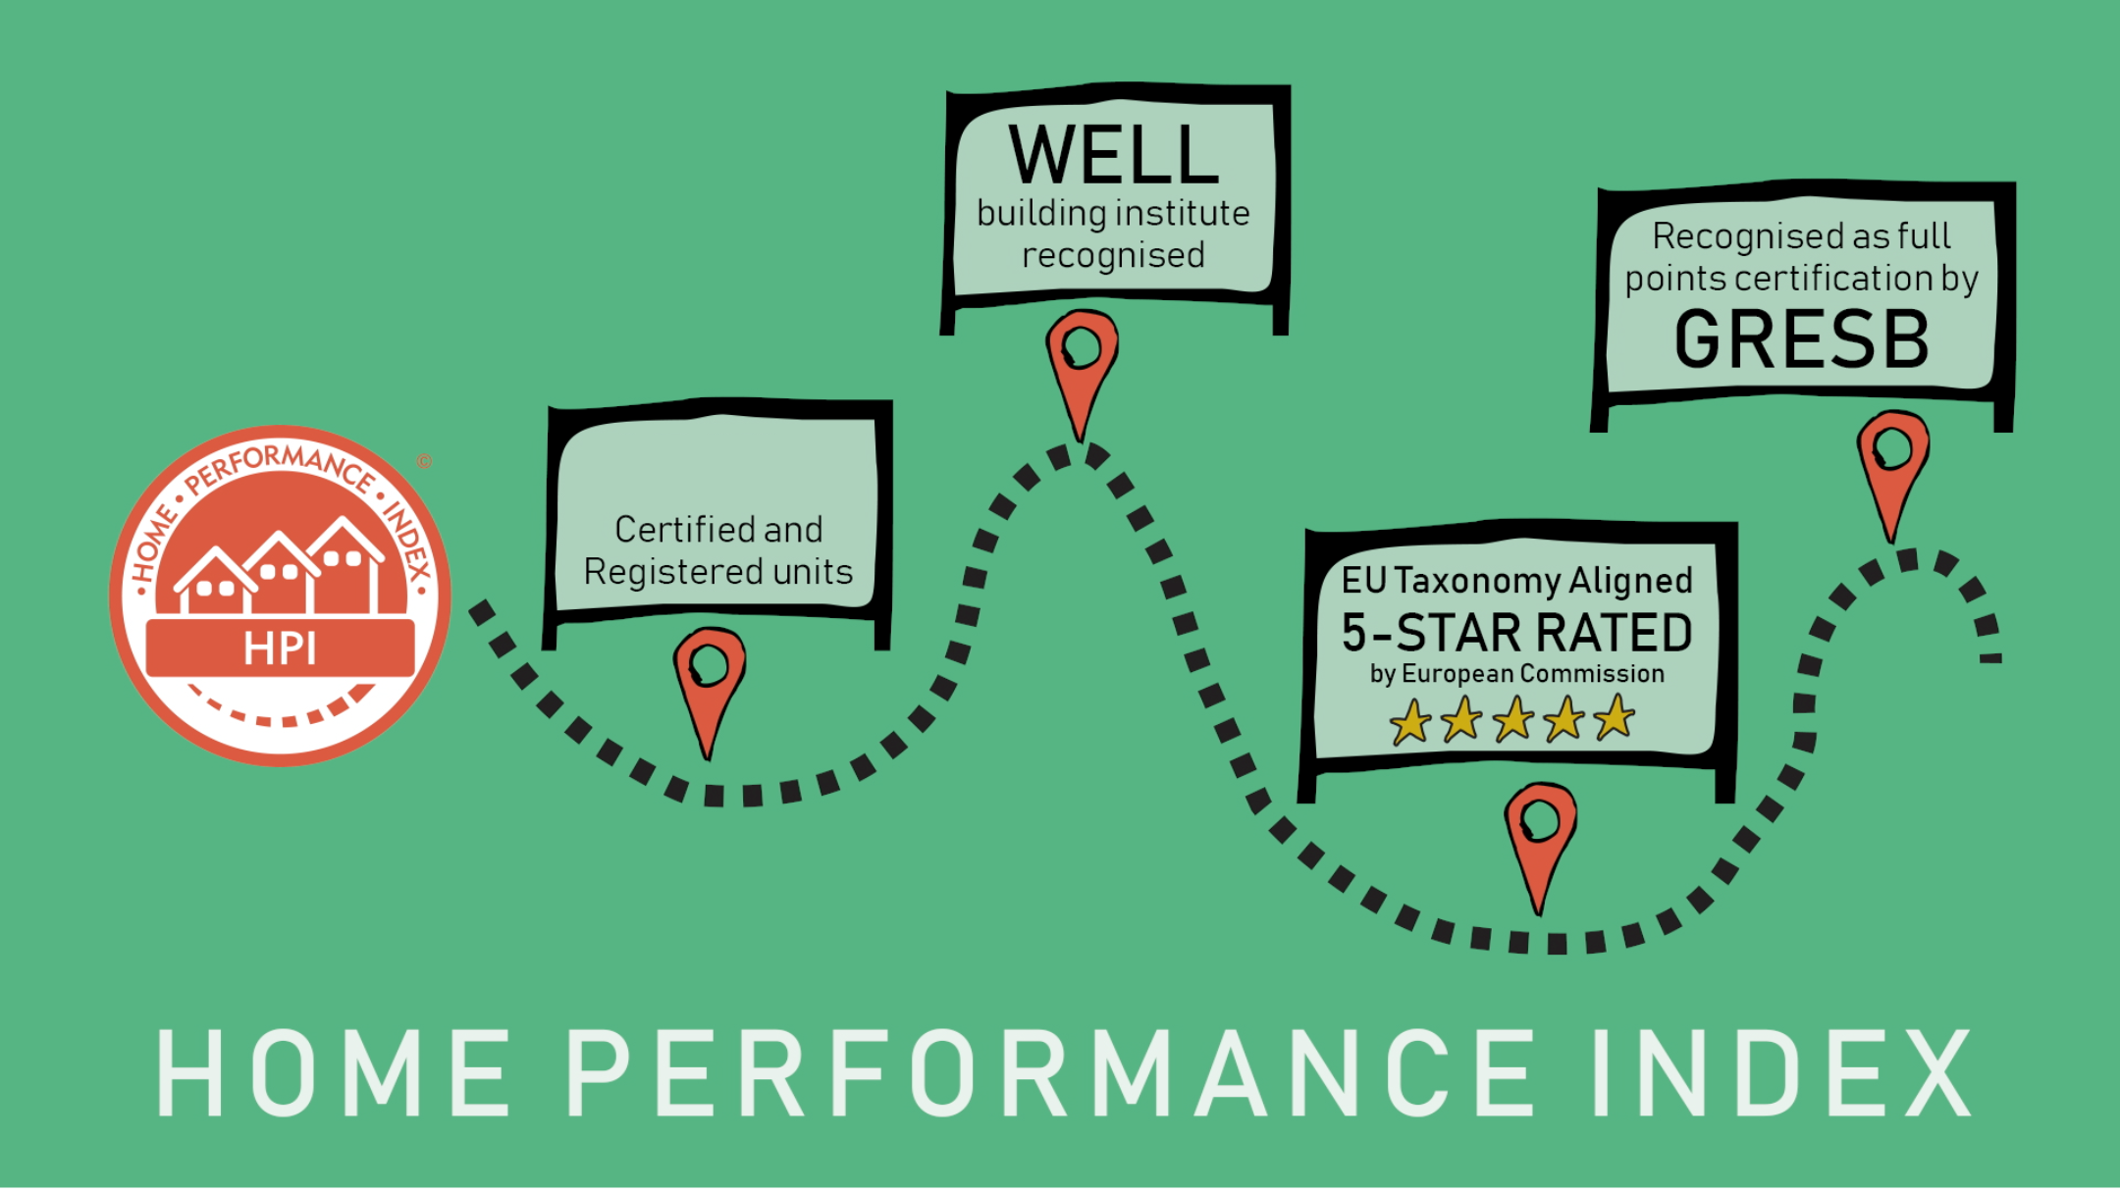
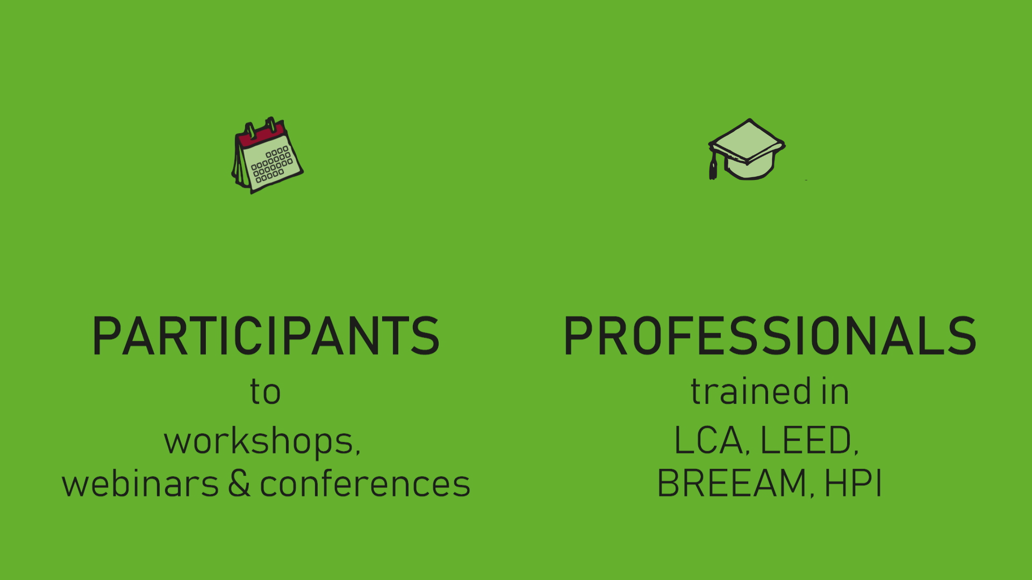
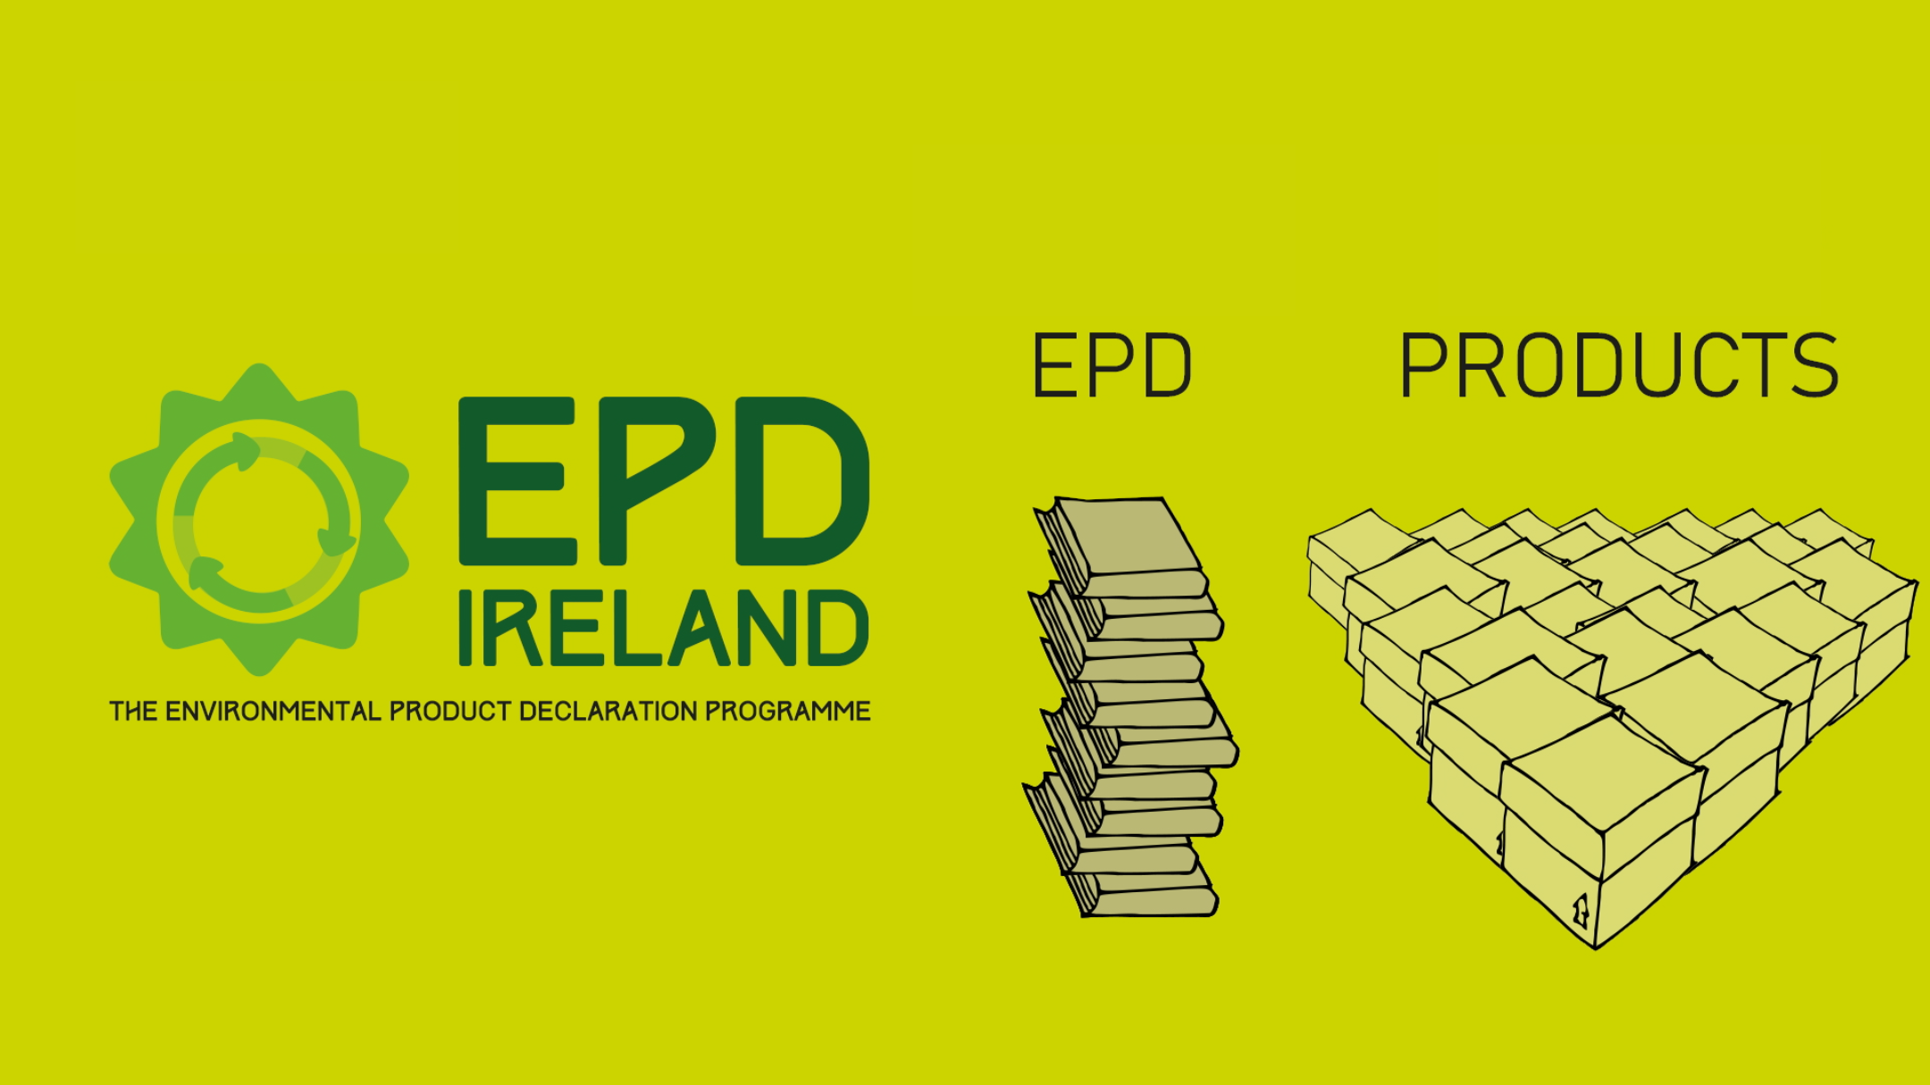
What we do
100+
22,000+
400+
100+
200+
250+
12,000+
900+
Digital resources on the LEARNING HUB
Collaborate Educate Rate Advocate Communicate Innovate
Notes:
You can update the numbers

Slide 4
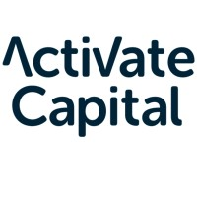
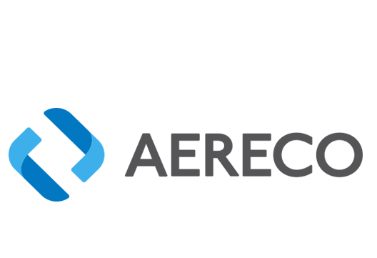
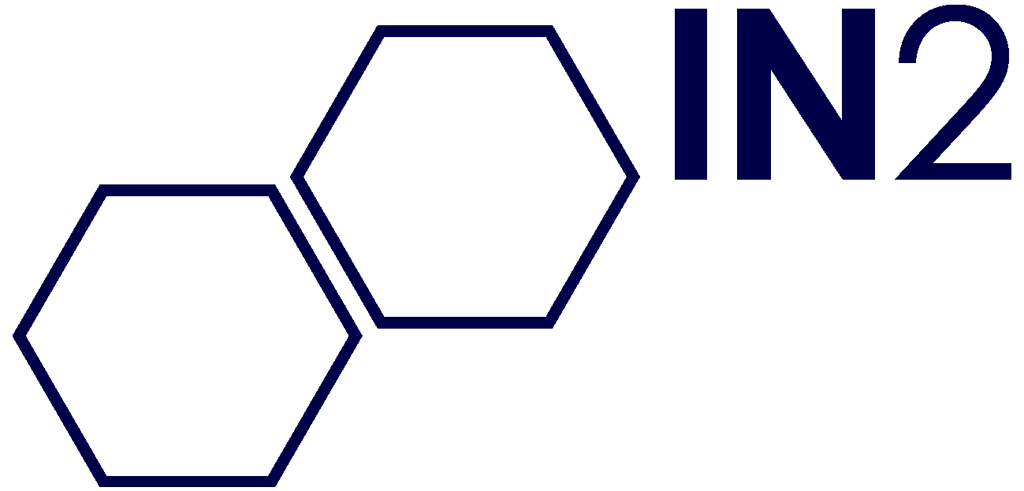
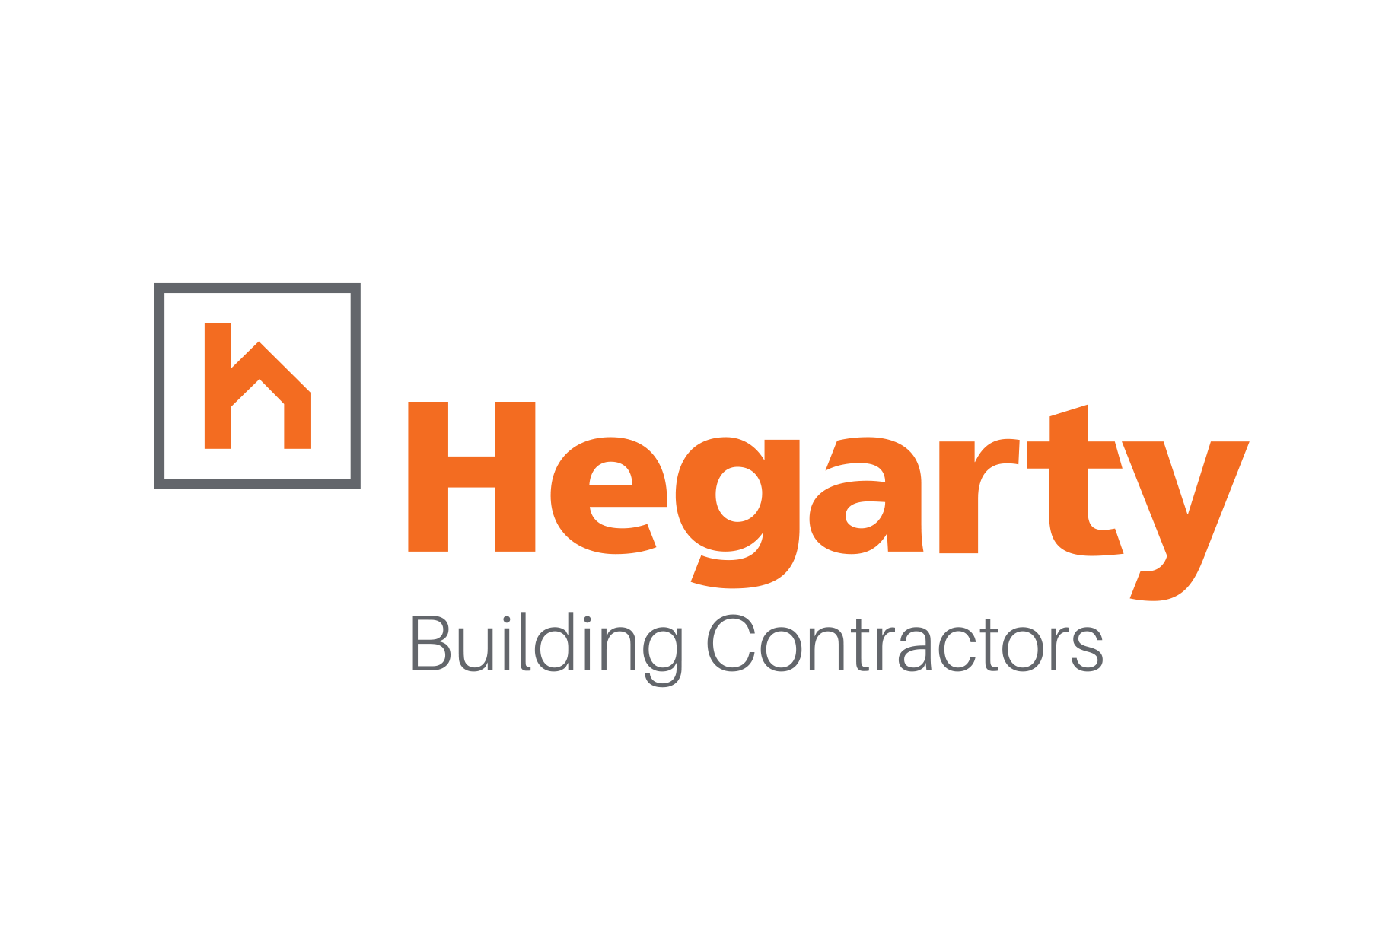
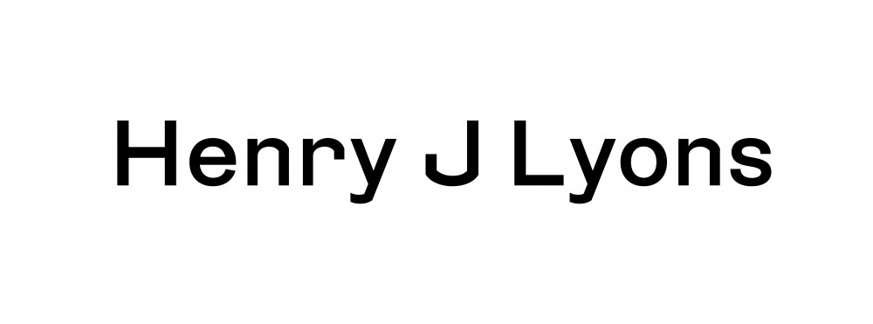
Notes:
391 members United in one common goal
Accelerate the transformation to a sustainable built environment, industry and supply chain through leadership, research, education, and policy into national and local government

Slide 5
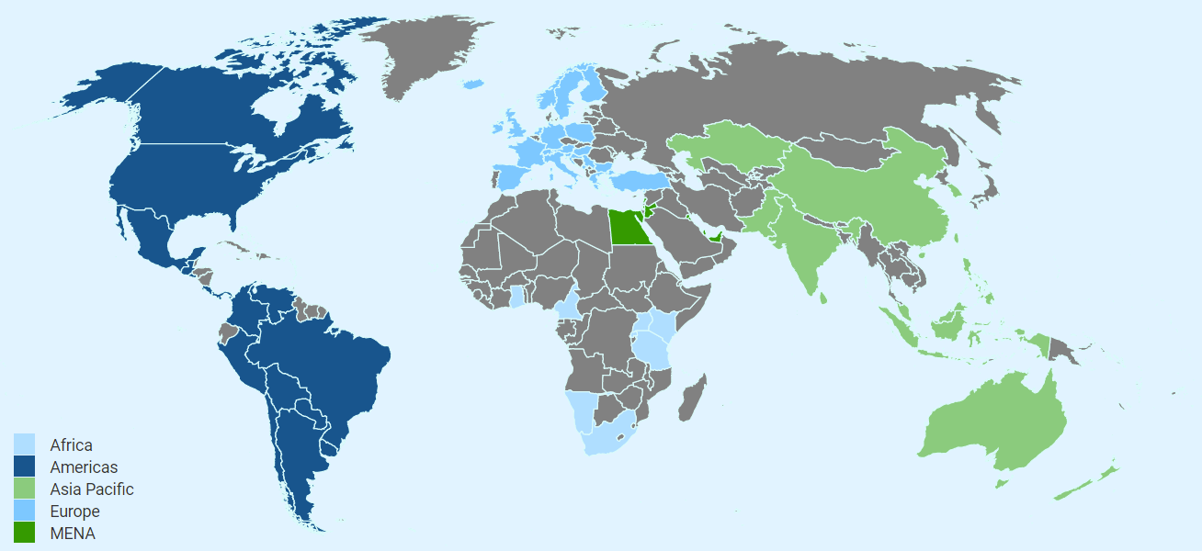
World Green Building Council
70 countries 35K+members
World Green Building Council

Slide 6
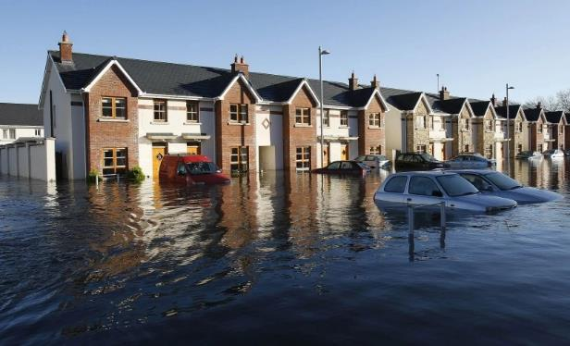
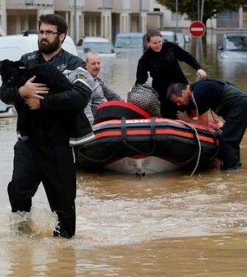
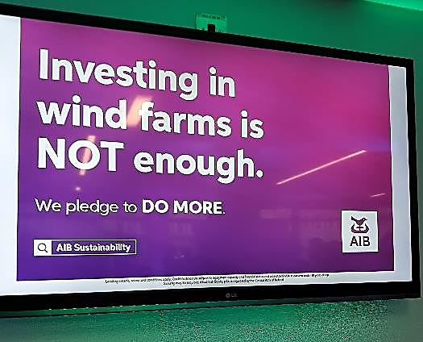
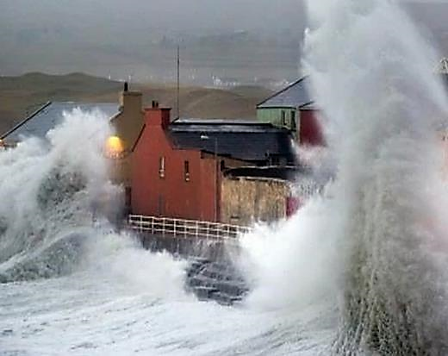
Threats to financial stability – Physical + Transition
Losses from weather events jumped from €50bn in mid 80s
to €150bn today
“The outlook for Ireland
is not optimistic”
EPA State of the Environment Report 2020
Outlook
Notes:
https://www.google.com/imgres?imgurl=https%3A%2F%2Famp.independent.ie%2Fincoming%2F1cb5a%2F29893254.ece%2FAUTOCROP%2Fw300%2Fclontarf_2.jpg&imgrefurl=https%3A%2F%2Fwww.independent.ie%2Firish-news%2Fsuperstorm-leaves-a-300m-trail-of-devastation-29893662.html&tbnid=YtxLPFlLIV5Q9M&vet=12ahUKEwjtjbf7tensAhXAWRUIHdNQDxIQMyghegUIARDdAQ..i&docid=38-Tya064nMCTM&w=300&h=202&q=images%20-%20flooding%20-%20clontarf&safe=active&client=firefox-b-d&ved=2ahUKEwjtjbf7tensAhXAWRUIHdNQDxIQMyghegUIARDdAQ

Slide 7
Impact of the built environment in Europe
39%
emissions
40%
Energy
consumption
50%
All raw
material
extraction
CO2
Over 50%
All waste
generation
1/3
All potable
water usage
28%
Operational
CO2
11%
Embodied
CO2

Slide 8
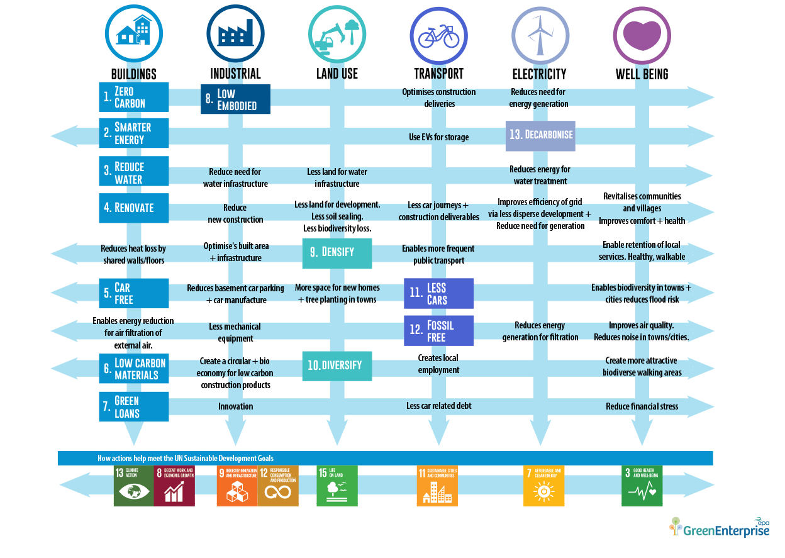
Cross cutting Actions & Outcomes for radical reductions in
CO₂ emissions from the built environment

Slide 9
The CO₂ Performance Ladder
for low carbon procurement in Ireland
The power of procurement

Slide 10
European Context - GPP
Public procurement can serve as an opportunity to address the embodied carbon in buildings over their life cycle. In this regard, contracting authorities are important actors that can take action as part of procurement procedures by purchasing new buildings that address global warming potential over the full life cycle.
Notes:
And all this thinking is finding its way into the re-working of the GPP Criteria guidelines. The JRC is currently re-drafting its criteria guidance on GPP, which it expects to publish early next year, and as we’ll see, its draft structure is based on the same objectives as Levels…These new proposals apply not only to office buildings, but also to schools and social housing, and the same criteria could also be used in other types of public buildings or in the private sector.
Take a look at the first technical report here if you have the chance – it gives a detailed first draft of where things are heading. There are still outstanding questions posed throughout the report so if you think there is anything you can contribute you may want to contact the JRC directly…

Slide 11
What is Green Public Procurement?
Green Public Procurement (GPP) is a process where public authorities seek to source goods, services or works with a reduced environmental impact.
Green Public Procurement (GPP) policies will play a vital part in reducing our global carbon impact and protecting our natural resources and the environment.
Ireland has committed to implementing GPP in all tenders using public funds.
This will require a major shift in the practices of public bodies and the businesses they contract with.
Notes:
This is a sample of a slide with the IGBC branding bar appearing at the bottom of the screen, which is likely the most common usage.
The branding bar itself is a single transparent image that can be copied and pasted across slides.

Slide 12
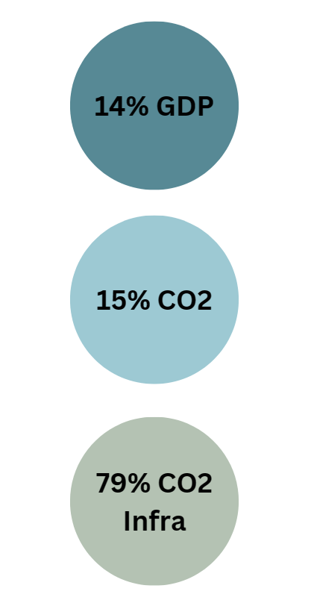
Why Green Public Procurement?
European Governments spend almost 14% of their GDP on procurement.
This is responsible for around 15% of global carbon emissions.
Infrastructure and the construction sector are responsible for almost 80% of the carbon emissions
In Ireland, public bodies (excluding utilities) spend an estimated €18.5 billion a year
This provides Ireland’s public sector with significant influence to stimulate and actively encourage the provision of more resource-efficient, low carbon, less polluting goods, services and works across the public sector.
Notes:
This is a sample of a slide with the IGBC branding bar appearing at the bottom of the screen, which is likely the most common usage.
The branding bar itself is a single transparent image that can be copied and pasted across slides.

Slide 13
Notes:
I’m going to tell you about Levels in a bit more detail now because we’re starting to see it appearing in more and more documents….(CLICK)
in the national policy for architecture – it is referenced as essential for making comparisons of proposals and identifying what it is exactly we want our buildings to do and what the impacts may be,(CLICK) and it advocates both more public sector use of the Levels framework and bringing Levels into the regulations on environmental impacts of building products..(CLICK)
EPA GPP guidance

Slide 14
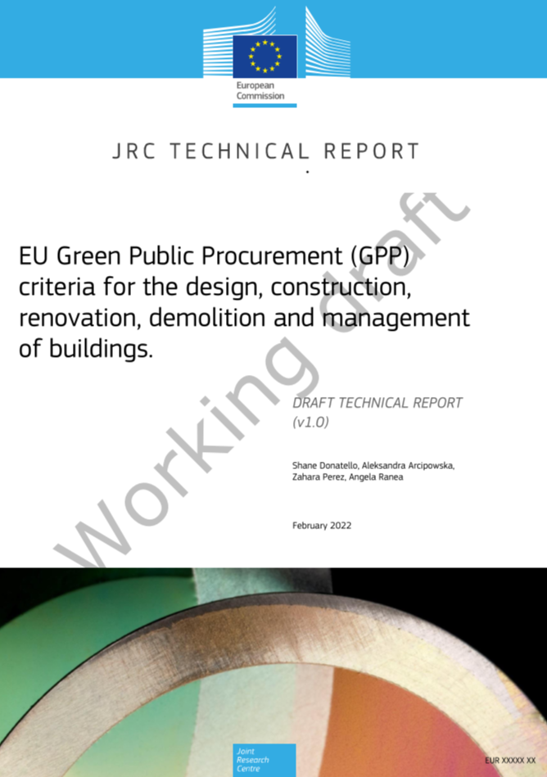
European Context - GPP
See here for project details:
https://susproc.jrc.ec.europa.eu/product-bureau//product-groups/408/project-plan
See here for draft:
https://susproc.jrc.ec.europa.eu/product-bureau//sites/default/files/2022-03/GPP_Buildings_TR_v1.01.pdf
Notes:
And all this thinking is finding its way into the re-working of the GPP Criteria guidelines. The JRC is currently re-drafting its criteria guidance on GPP, which it expects to publish early next year, and as we’ll see, its draft structure is based on the same objectives as Levels…These new proposals apply not only to office buildings, but also to schools and social housing, and the same criteria could also be used in other types of public buildings or in the private sector.
Take a look at the first technical report here if you have the chance – it gives a detailed first draft of where things are heading. There are still outstanding questions posed throughout the report so if you think there is anything you can contribute you may want to contact the JRC directly…

Slide 15
The CO₂ Performance Ladder
The implementation of green procurement provides the benefits of reducing both operational and environmental costs but procuring green materials and technologies often incur higher costs than the conventional procurement approach.
CO2 PL is an affordable tool to aid this process.

Slide 16
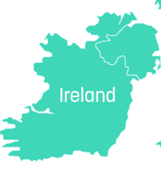
SKAO
CO2 Management system
Green public procurement tool
Implementation in Ireland
Ireland
The CO₂ Performance Ladder

Slide 17
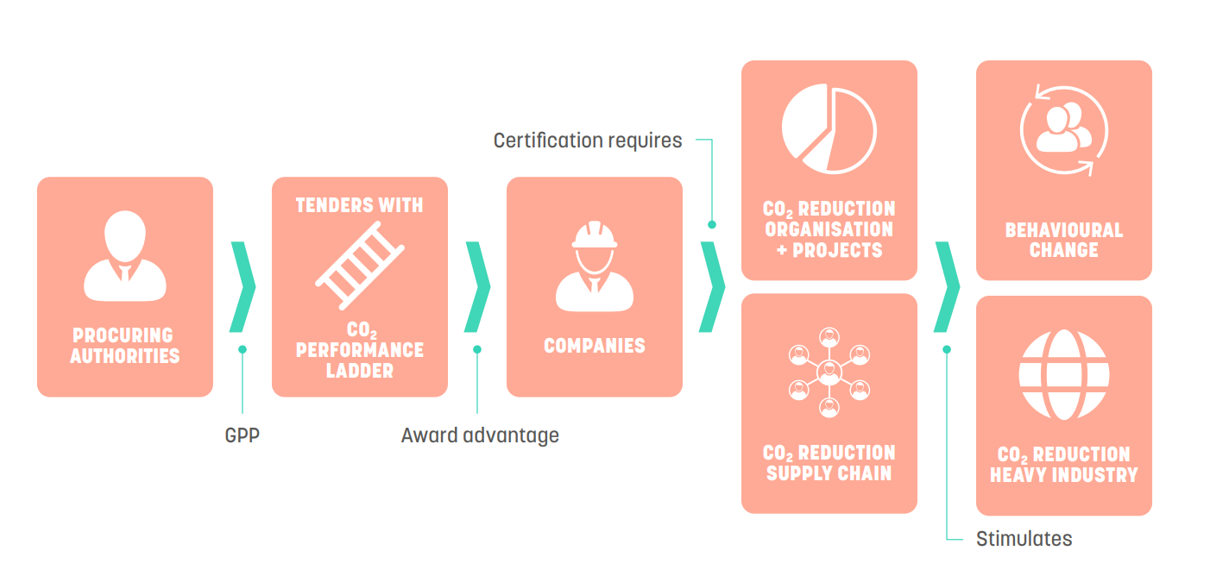
Theory of Change
The CO₂ Performance Ladder is an effective procurement tool that uses the ‘Power of Procurement’ to stimulate structural decarbonisation.
Third party verification
CO₂ reduction is rewarded with award (financial) advantage for the bidding companies. The higher the ambition level of the company, the higher the award advantage.

Slide 18
Foundation for Climate Friendly Procurement and Business
Owner, administrator of CO₂ Performance Ladder
Independent, not-for-profit, politically neutral
Market instrument: SKAO brings together all stakeholders (procuring parties, companies and NGOs)
Development and implementation of both certification scheme and procurement instrument
Capacity building: we collaborate, connect, do research and share knowledge
Procuring parties
Companies
Experts

Slide 19
The impact of the CO₂ Performance Ladder
CO2PL is GPP best practice (OECD, IPCC, WEF)
Tendering with the CO2PL leads to accelerated decarbonization and innovation (CE Delft, 2023)
Carbon reduction = twice as fast (CE Delft, 2023 & PhD research, 2017)
The CO2PL leads to institutionalisation of carbon reduction and awareness and behavioural changes (CE Delft, 2023)
CO2PL is used in circular procurement (RIVM, 2020)

Slide 20
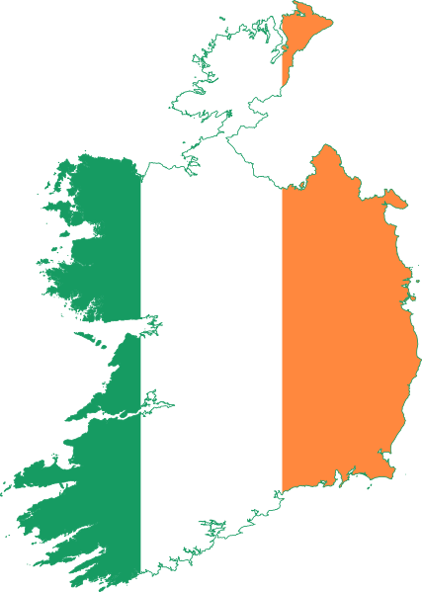
15 years CO₂ Performance Ladder
Standard GPP instrument in the Netherlands and Belgium
300 public procuring authorities use the CO2PL as a GPP tool
1500 certificates (~5000 organisations) → >75% SME
2023

Slide 21
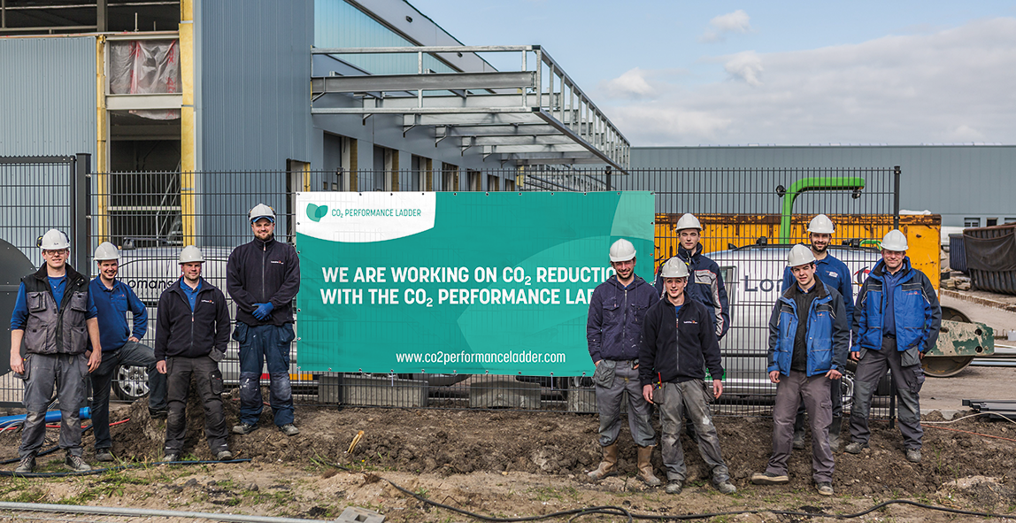
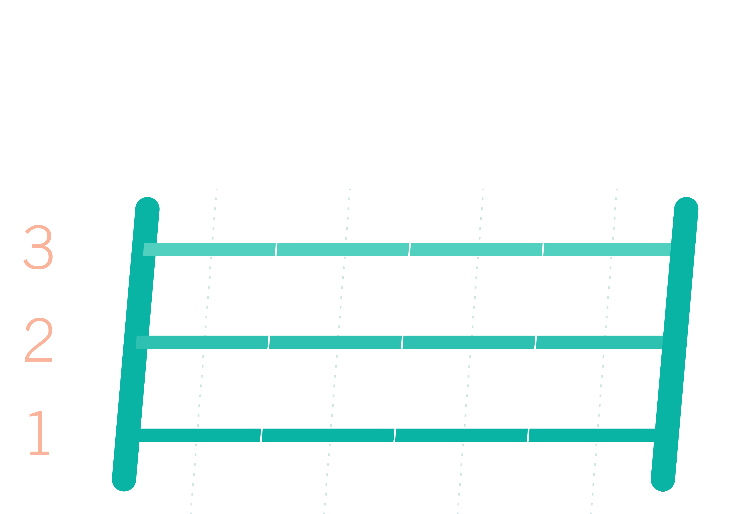
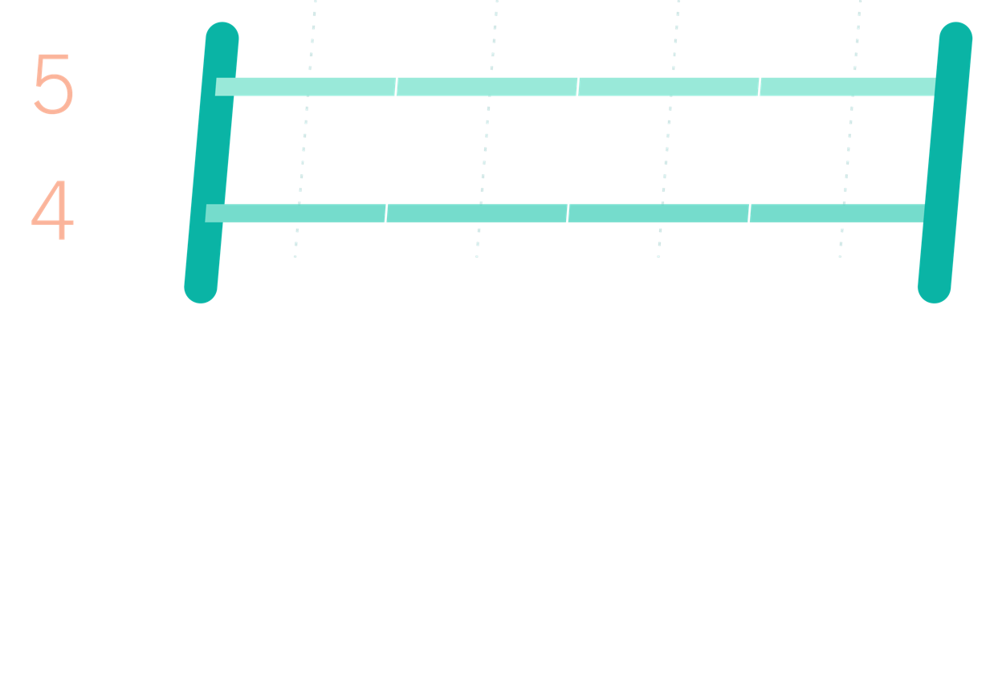
What is the CO₂ Performance Ladder?
CO₂ management system
Green Public Procurement (GPP) tool
CO₂ Ambition level | Award advantage
Level 5 | 10 %
Level 4 | 7 %
Level 3 | 4 %
Level 2 | 2 %
Level 1 | 1 %

Slide 22
What does a certified organisation have?
Ambitious reduction targets
Insights
(verified carbon footprint)
Innovation and
collaboration
Transparency
and communication
CO₂ Management system (yearly assessed by accredited 3rd party)

Slide 23
What does a certified organisation have?
Level 4, 5 Scope 1 + 2 + 3 emissions
Supply chain + industry
Level 1, 2, 3 Scope 1 + 2 emission
Own organisation + projects
Ambitious reduction
targets
Transparency and communication
Innovation and
collaboration
Insight

Slide 24
Key documents for certification

Slide 25
Assessment and audit
Annual third party accreditation (TÜV, Bureau Veritas, Vinçotte, DNV, etc)
Scope audit: requirements CO₂ Performance Ladder → Handbook
Scope requirements:
CO₂ management system
Requirements/level
Requirements on project level
CO₂ Performance Ladder standard (requirements)

Slide 26
What is the CO₂ Performance Ladder?
Green (public) procurement tool
CO₂ Ambition level | Award advantage
Level 5 | 10 %
Level 4 | 7 %
Level 3 | 4 %
Level 2 | 2 %
Level 1 | 1 %
Notes:
Getting certified is important to the green business case of organisations, due to the reward certified organisations can get in procurement processes
Governments can stimulate carbon reduction and support the green economy by harnessing their PoP
Then the GPP tool. Essentially, the co2pl can be inserted into tenders as an award criteria whereby tendering organisations get points or a financial advantage based on their ambition level, 1-5. These levels correspond with the levels of the ladder, and a certificate is adequate proof to submit that ambition level, but this can also be proved at project-level if preferred (through an audited project declaration). Also the ladder is always optional – tendering parties can submit ambition level 0 if they prefer, but will of course then receive no bonus.

Slide 27
The Ladder and Procurement
CO₂ awareness certificate level | Award advantage
Level 5 | 10 %
Level 4 | 7 %
Level 3 | 4 %
Level 2 | 2 %
Level 1 | 1 %
Company | Entry Price | Level on the CO2PL? | Fictitious discount/ award advantage | Fictitious price | Award the contract?
A | € 9,7 million | none | 0% | € 9,7 million | NO
B | € 10 million | 3 | 4% | € 9,6 million | NO
C | € 10,3 million | 4 | 7% | € 9,58 million | YES € 10,3 million

Slide 28
Procuring party
Company

Slide 29
CO₂ Performance Ladder: GPP documents
Procurement Guide (EN)
Legal FAQ (EN)

Slide 30
Procuring authorities
Advantages for…
Companies
Proven methodology: the CO2PL is the standard GPP tool in the Netherlands and Belgium.
User-friendly, with low transaction costs for getting started.
Third party certification lowers the burden on procurement authorities to verify claims.
Compliant with the EU Procurement Directive, immediately applicable in other EU countries.
Green business case.
Effective at structural carbon reduction.
Reinforces market position as a sustainable supplier, and helps improve products and services.
Multi-use: one certificate can be used for all projects for all contracting authorities using the Ladder in their procurement.

Slide 31
Want to know and learn more about the CO2PL?
Academy
Testimonials
Examples

Slide 32
Implementation in Ireland
IGBC as coordinating partner
Responsible for implementation in Ireland, first contact point.
Communication, capacity-building, support to Irish parties (business and procuring authorities)
SKAO and project partners in supportive role
First procurement process with TII – others to follow
Notes:
We’re making an exception, normally more independent than this, in NL wouldn’t explain to individual business how Co2PL works, but given just starting in IE and IGBC getting up to speed

Slide 33
TII is fully committed to carbon emission reduction and to the advancement of a greener future for Ireland. We believe that the CO₂ Performance Ladder is a practical tool that can help us achieve our sustainability goals.
Dr Vincent O’Malley, Head of Environmental Policy & Compliance at Transport Infrastructure Ireland
Implementation in Ireland
Notes:
We’re making an exception, normally more independent than this, in NL wouldn’t explain to individual business how Co2PL works, but given just starting in IE and IGBC getting up to speed

Slide 34
By incorporating the CO₂ Performance Ladder into their tendering processes, public bodies can send a clear message to the market: sustainability is not an option; it is an imperative. The CO₂ Performance Ladder is a proven instrument in public procurement and carbon emissions reduction. It has been highly successful in mainstreaming green public procurement in the Netherlands, and we are pleased to help bring it to Ireland.
Pat Barry, CEO at the Irish Green Building Council
Implementation in Ireland
Notes:
We’re making an exception, normally more independent than this, in NL wouldn’t explain to individual business how Co2PL works, but given just starting in IE and IGBC getting up to speed

Slide 35
CO₂ Performance Ladder

Slide 36
CO₂ Performance Ladder in Europe
Collaboration: SKAO, International Institute for Sustainable Development, ICLEI and Utrecht University
Funded by IKEA Foundation
Based on the power of green procurement to drive the climate transition.
April 2023-May 2025

Slide 37
Assessment & Audit in Ireland
Options:
Contact Dutch/Belgian Certification Body (could travel to Ireland to conduct audit)
Contact International CB active in Ireland with existing experience of CO2PL:
Bureau Veritas (UK & Ireland)
DEKRA
SGS
DNV
Long-term: CBs with experience of management systems (ISO 14001) could gain accreditation for Ladder assessments

Slide 38
Observations & Queries about CO₂PL
Is the Ladder aligned to green building certification schemes such as BREEAM and LEED?
Answer:
The Ladder is not a certification scheme for buildings/products/materials, but for organisations. Of course, the CO2PL could easily be combined with schemes like BREEAM, LEED, but they are targeting different aspects of the process.

Slide 39
Observations & Queries about CO₂PL
When do organisations pay for the CO2 PL?
Answer:
Organisations pay an annual fee. When organisations register with SKAO then they receive an invoice (for the part of the year that they will be certified for e.g. if they register in September they will pay 25% of the annual fee based on their size category, as outlined on the CO2PL website.) Thereafter they will be invoiced annually.

Slide 40
Observations & Queries about CO₂PL
If organisations do not participate in the CO2 PL at tender stage, do they lose out on points?
Answer:
Yes. Organisations submitting with no ambition level will receive no advantage at the award stage. Businesses can judge for themselves whether they want to invest in certification to increase their chances of winning the contract(s). The more tenders including the CO2PL as an award criteria, the greater the motivation.

Slide 41
rachel@igbc.ie
Notes:
The individual framed portraits are achieved through a combination of the image cropping tool in the “Picture Format” option and the drawing of a rectangular shape around it to frame it … a shape with only a line and set to “no fill”.
Each cropped image its frame is then Grouped as a unit, but can be ungrouped for editing.
The IGBC design device on the left of the screen can be copied and pasted across slides, as needed.

Slide 43
Thank you
Inspired?
contact rachel@igbc.ie
inspiring examples at
CO₂PL Testimonials
more information:
www.co2performanceladder.com
Notes:
Here is an alternative implementation of the IGBC design device, intended for use on slides with less content.

