Slide 1
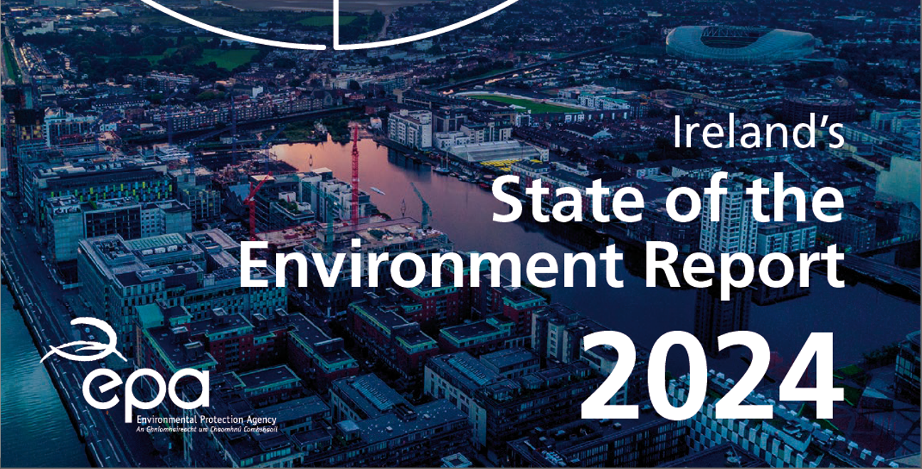
Title Page Options
Andy Fanning, Programme Manager, EPA, 14 Feb 2025

Slide 2
The Report (Once every 4 Years)
Executive Summary
Thematic
Sectoral
Implementation
Transport
Energy
Agriculture
Industrial
Circular Economy
Health & Well-being
Environmental Performance, Policy and Implementation
Air
Noise
Climate
Water
Marine
Nature
Soil
Land

Slide 3
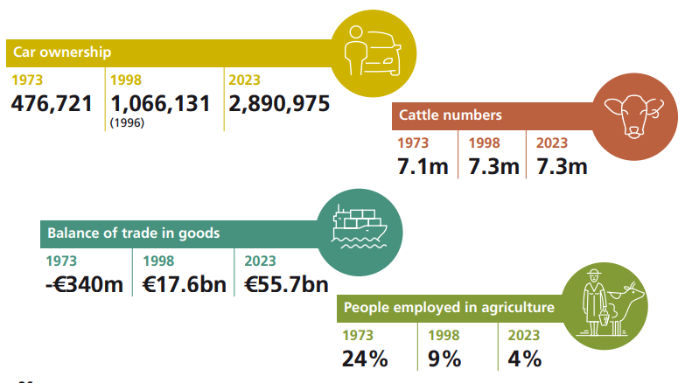
A changing country

Slide 4
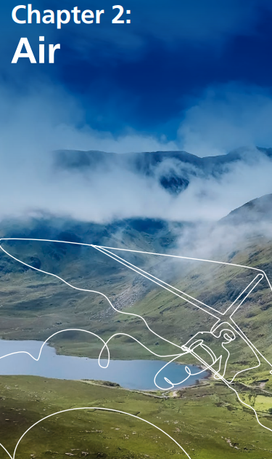
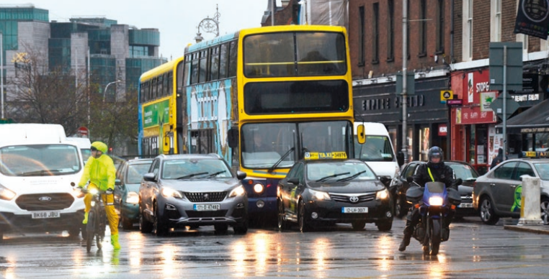
A changing country

Slide 5
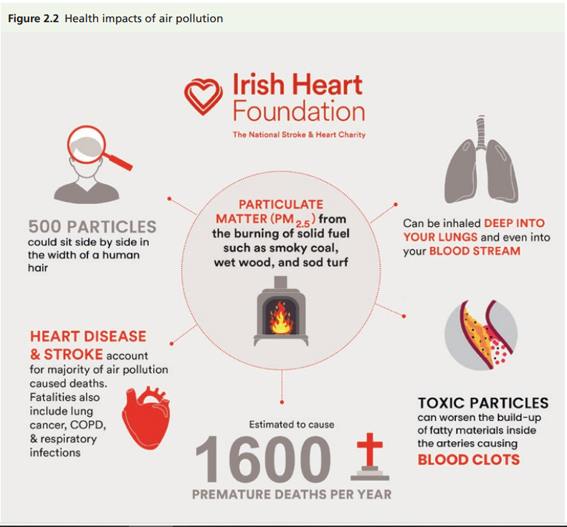
A changing country

Slide 6
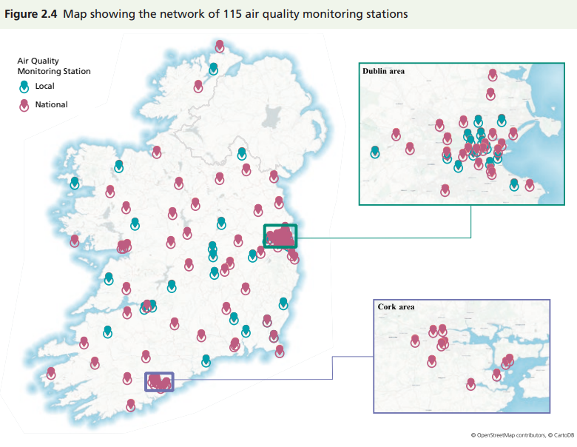
A changing country

Slide 7
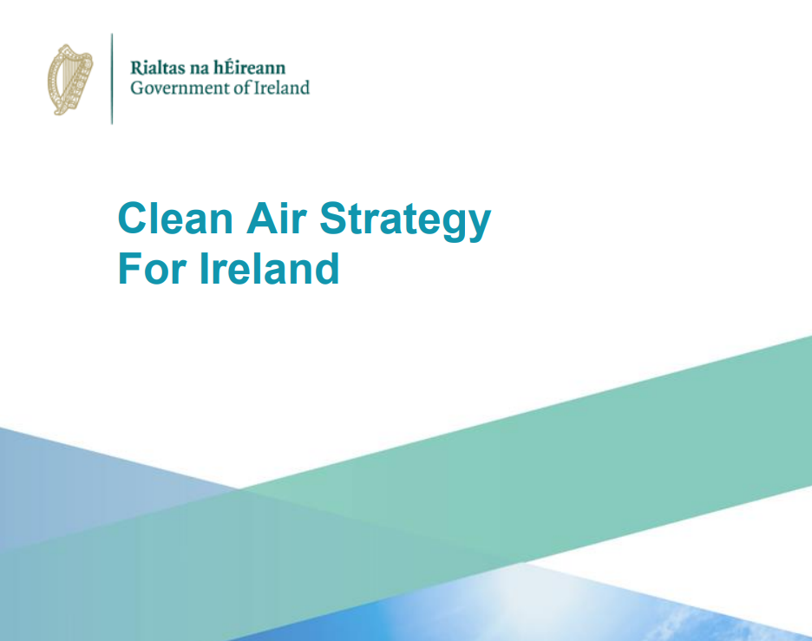
A changing country

Slide 8
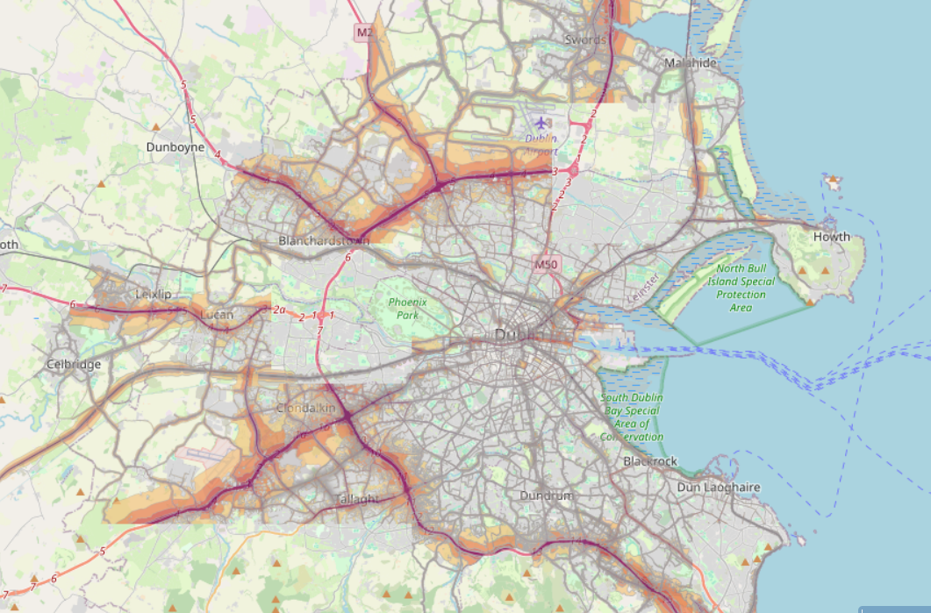
A changing country

Slide 9
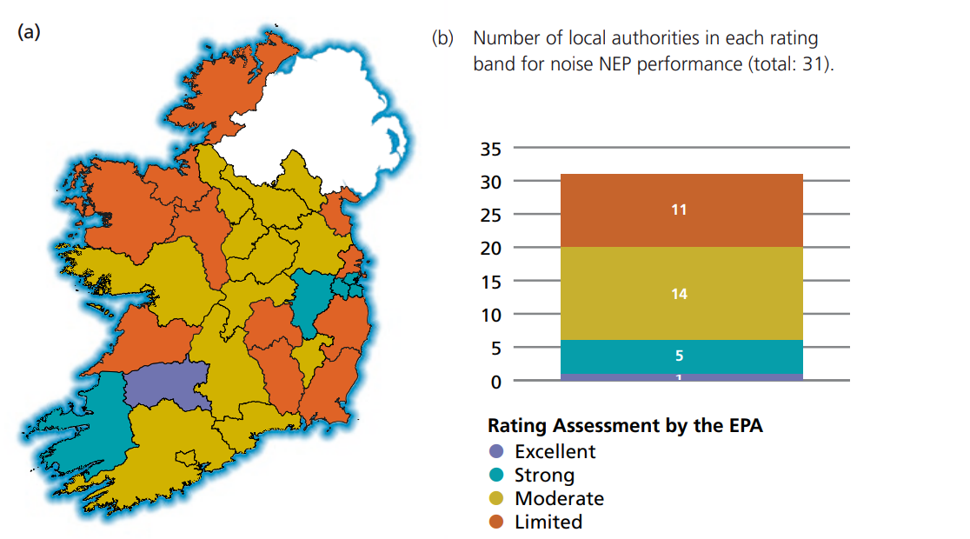
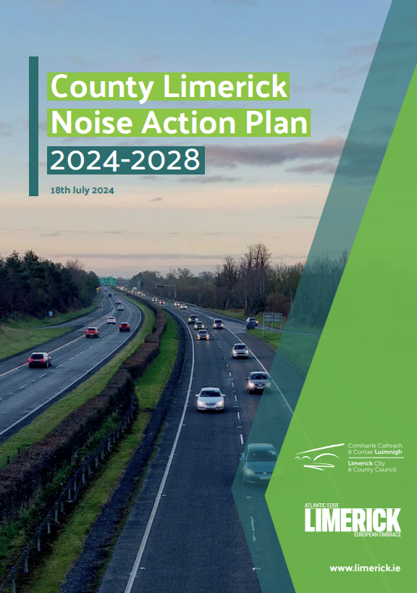
A changing country

Slide 10
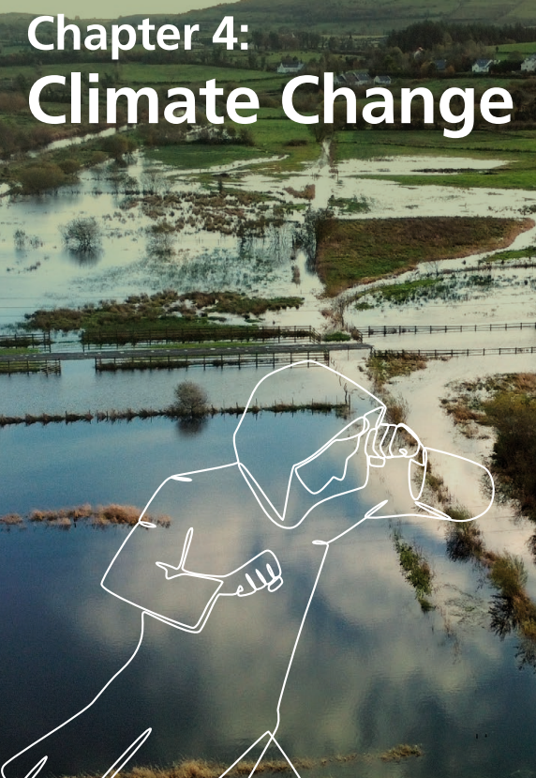
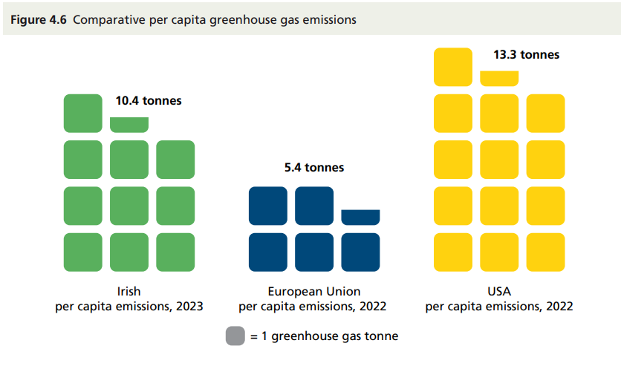
A changing country

Slide 11
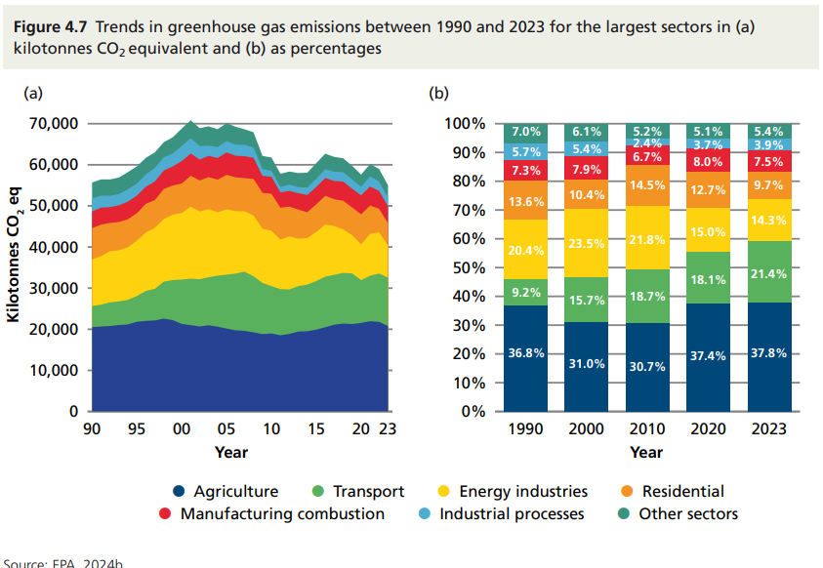
A changing country

Slide 12
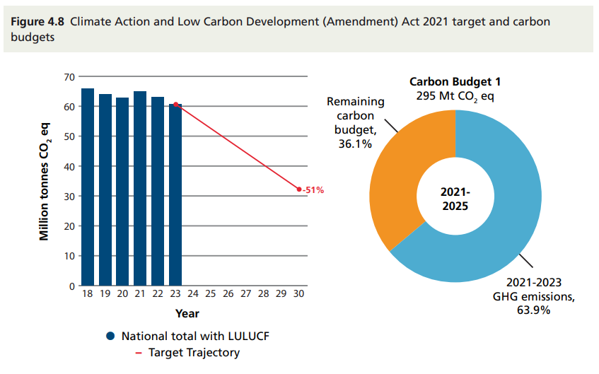
A changing country

Slide 13
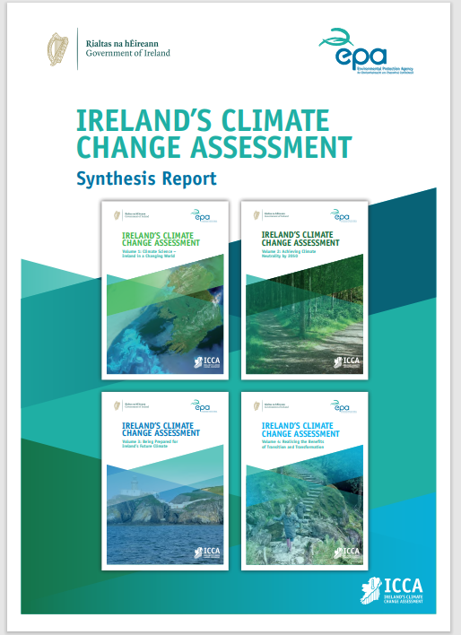
A changing country

Slide 14
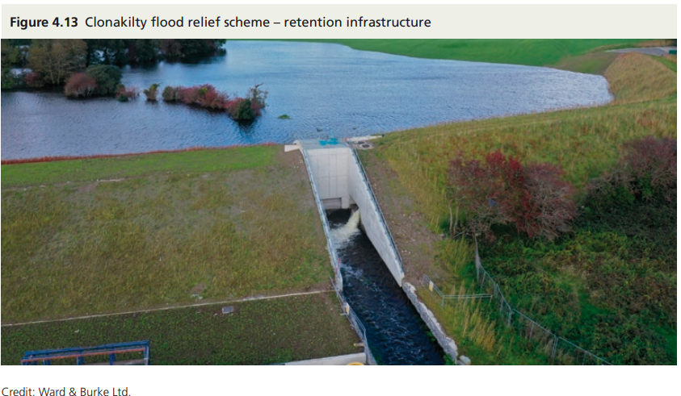
A changing country

Slide 15
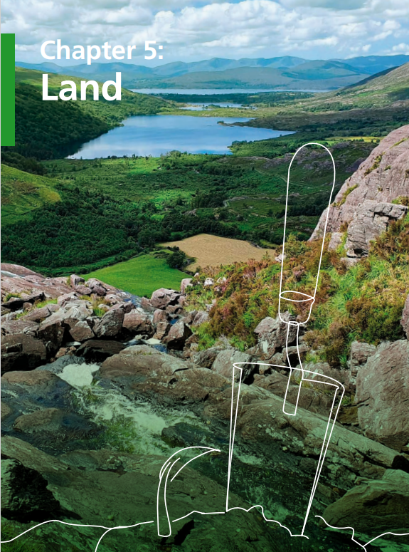
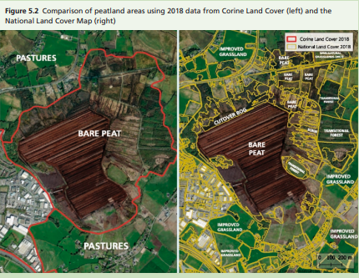
A changing country

Slide 16
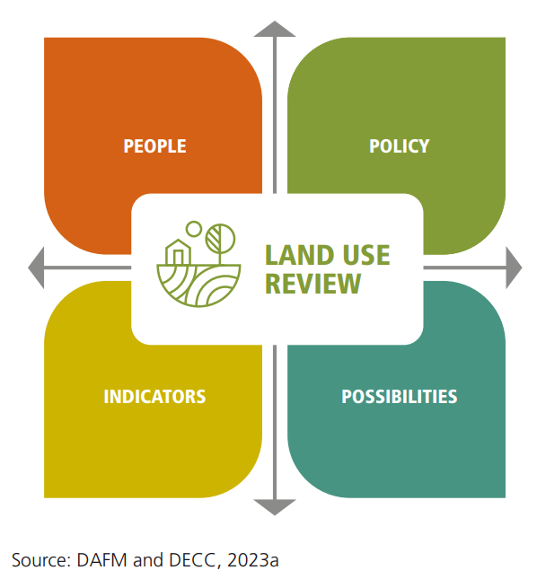
A changing country

Slide 17
A changing country
EU Biodiversity Strategy for 2030
EU Nature Restoration Law
National Biodiversity Action Plan
Ireland’s Forestry Strategy 2023– 2030
National Sustainable Mobility Policy 2022–2025
Ireland’s National Energy and Climate Plan 2021–2030
Sectoral climate adaptation plans

Slide 18
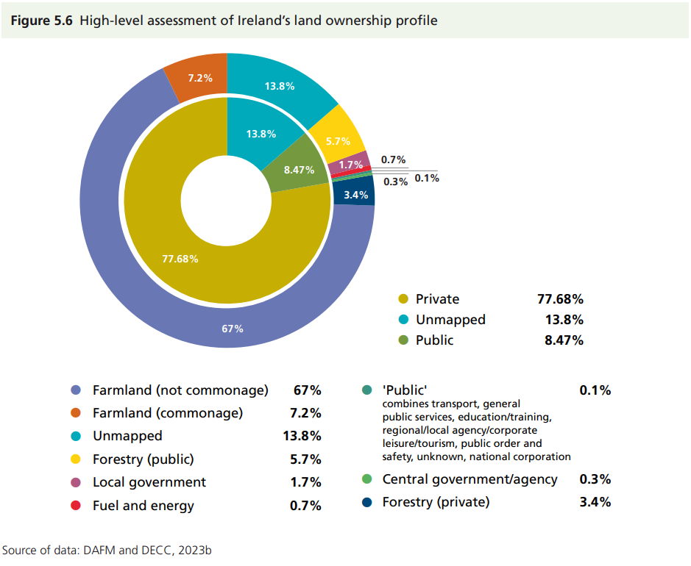
A changing country

Slide 19
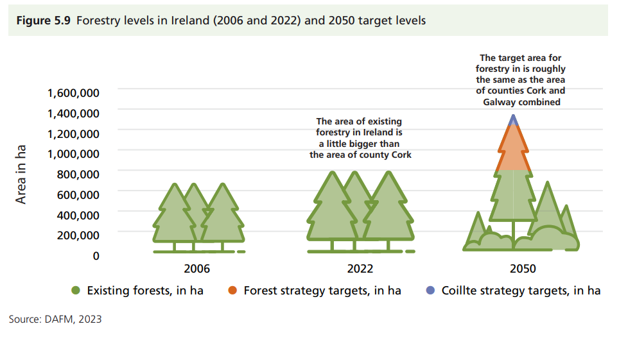
A changing country

Slide 20
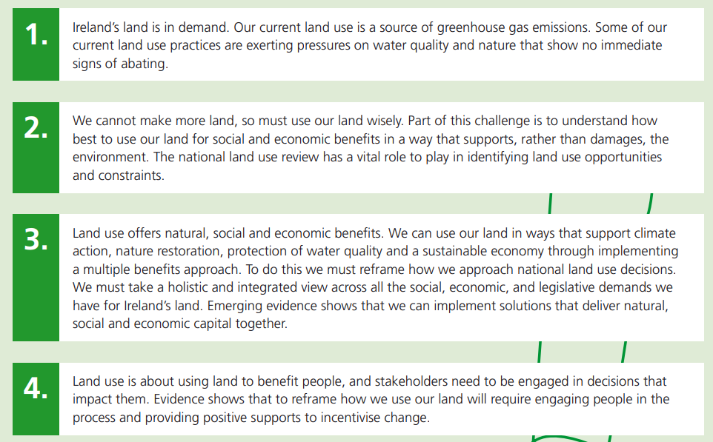
A changing country

Slide 21
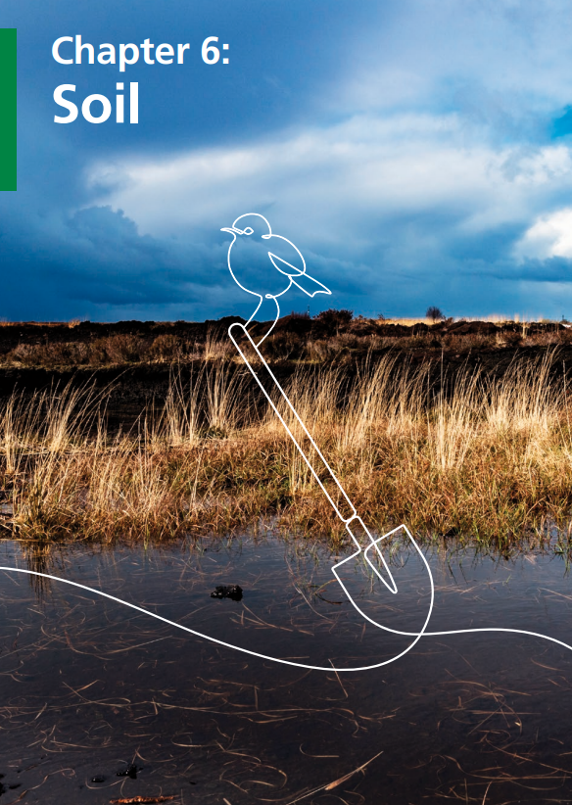
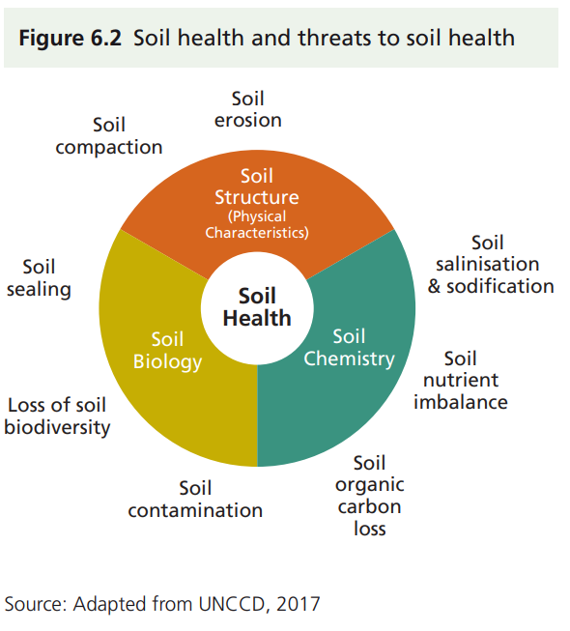
A changing country

Slide 22
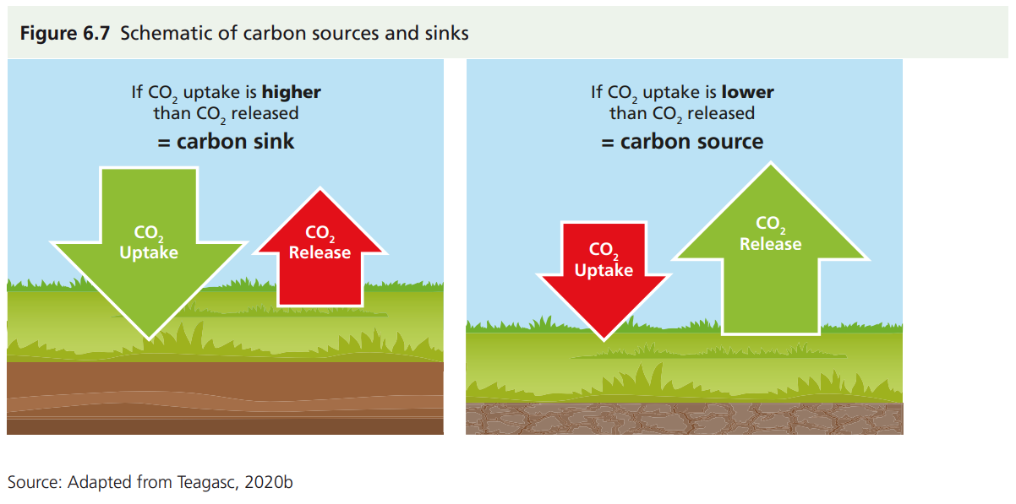
A changing country

Slide 23
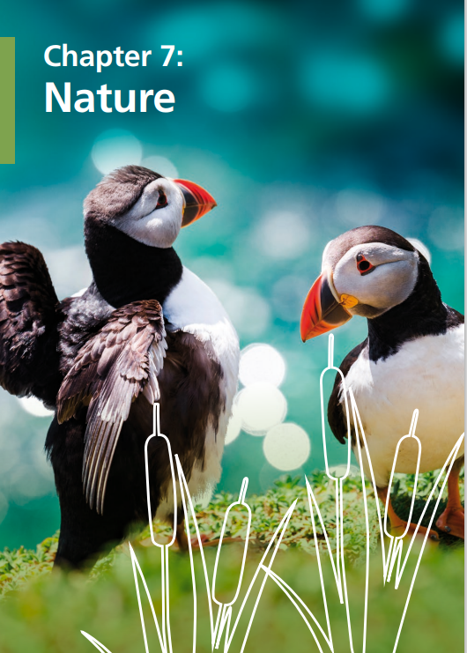
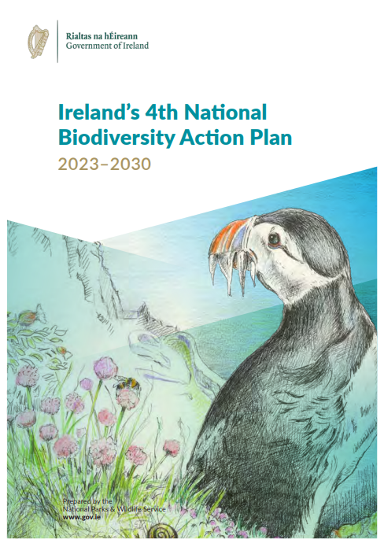
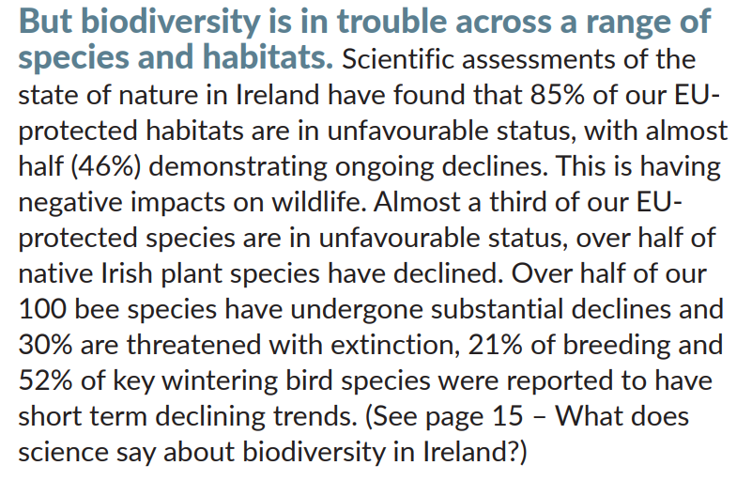
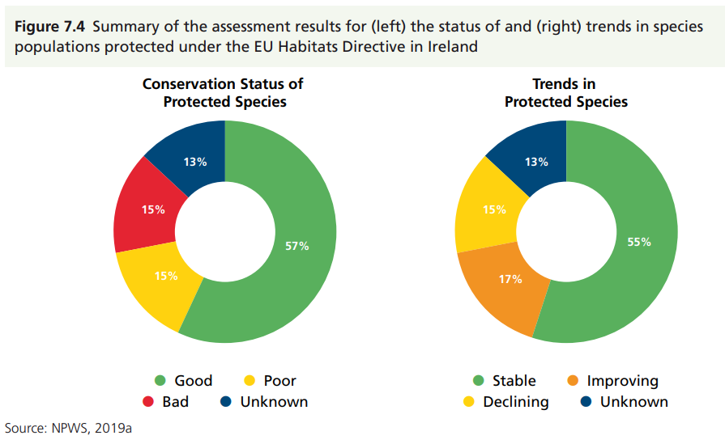
A changing country

Slide 24
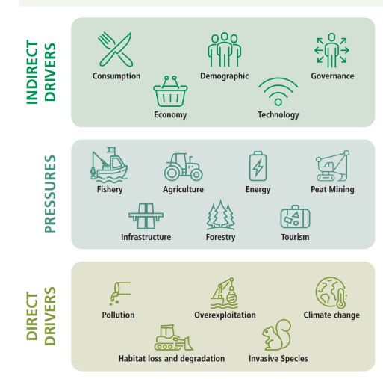
A changing country

Slide 25
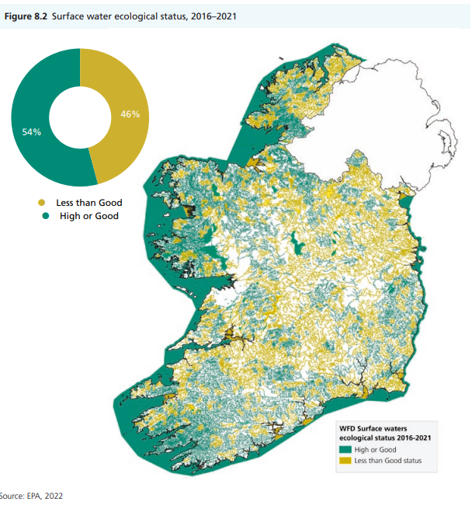
A changing country

Slide 26
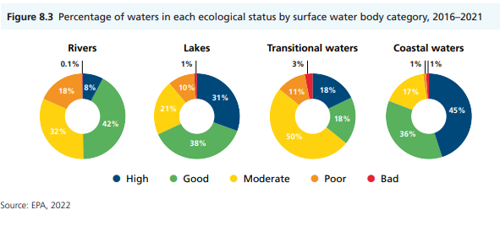
A changing country

Slide 27
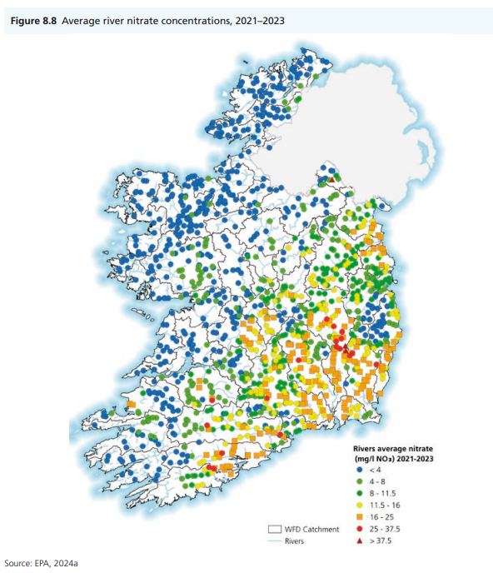
A changing country

Slide 28
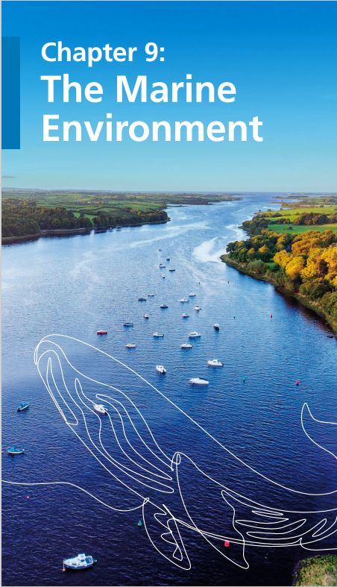
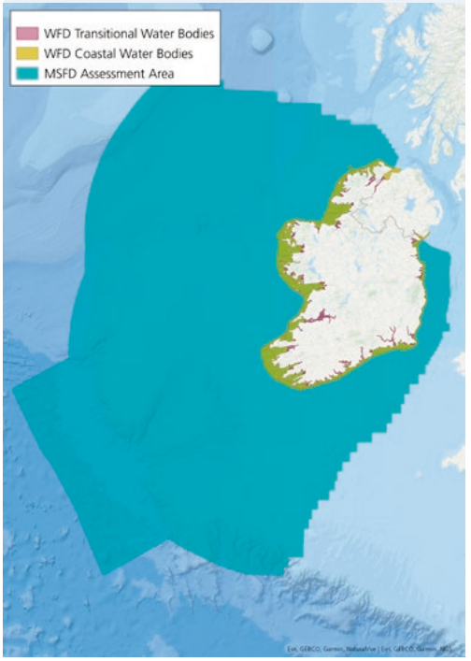
A changing country

Slide 29
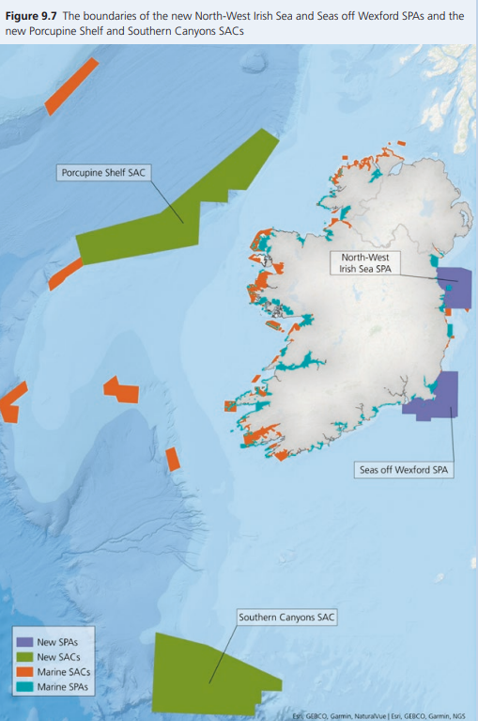
A changing country

Slide 30
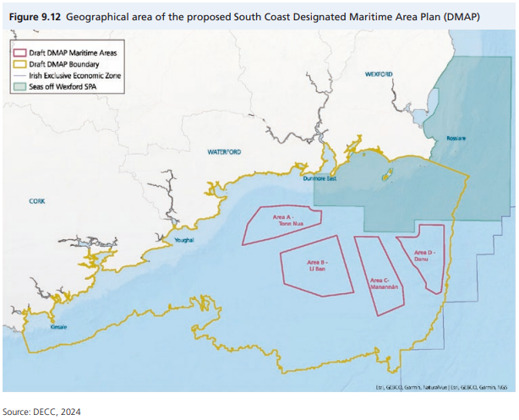
A changing country

Slide 31
A changing country

Slide 32
A changing country

Slide 33
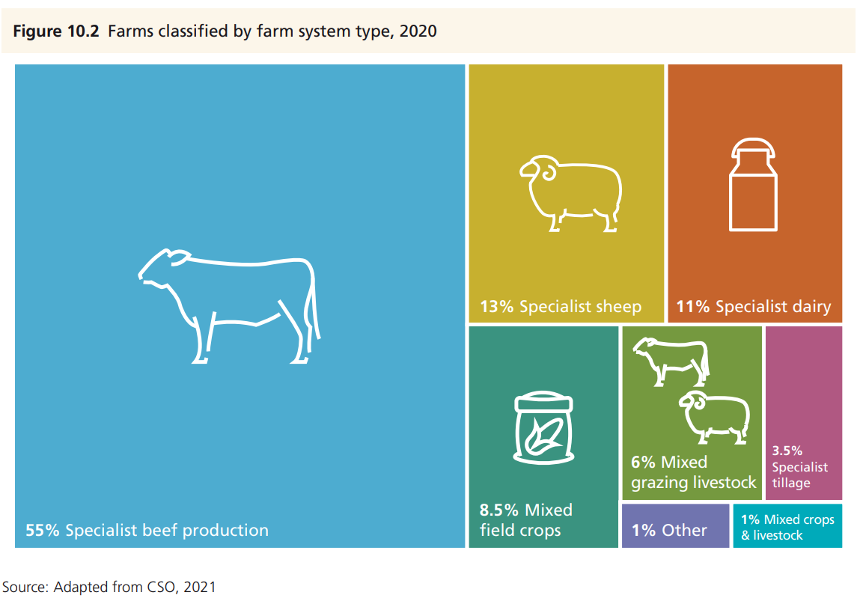
A changing country

Slide 34
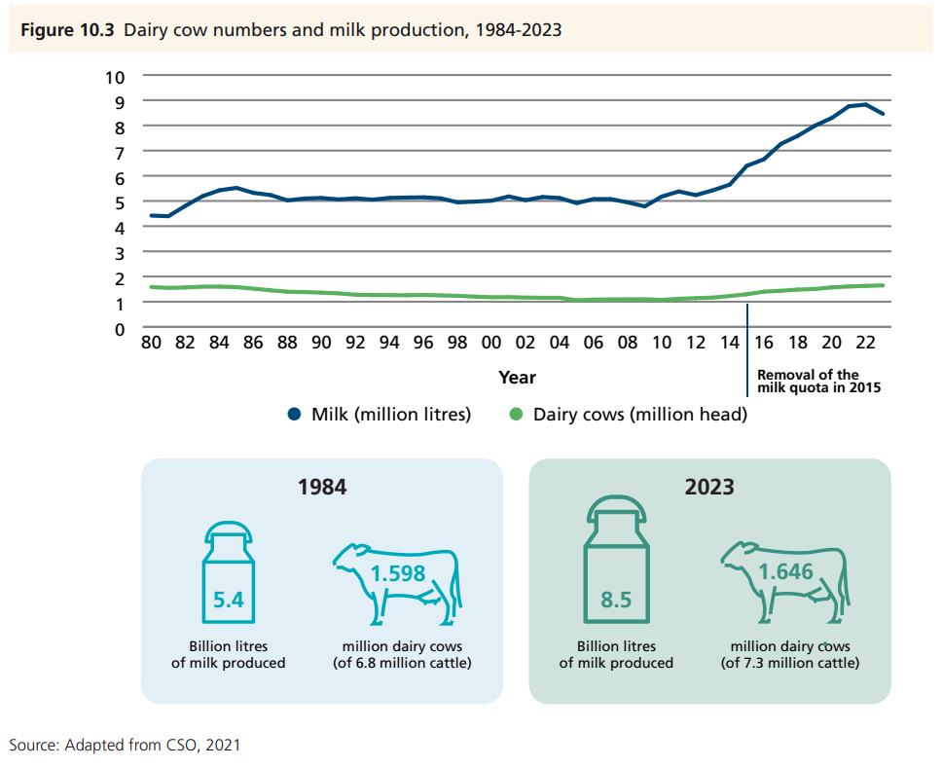
A changing country

Slide 35
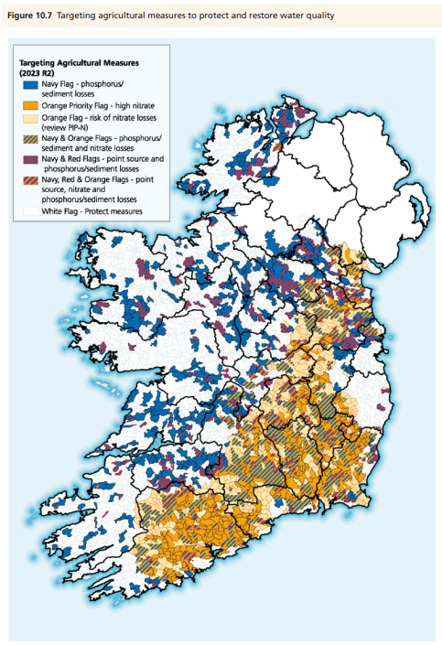
A changing country

Slide 36
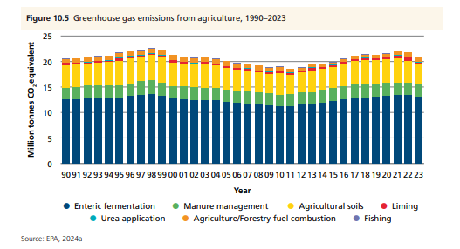
A changing country

Slide 37
A changing country
Ireland’s CAP Strategic Plan 2023–2027/
Agri-environmental schemes
Food Vision 2030
The National Biodiversity Action Plan
Water Action Plan 2024
Nitrates Action Programme
Teagasc marginal abatement cost curves
Agricultural Sustainability Support and Advice Programme
European Innovation Partnership, LIFE and other locally led environmental projects
Teagasc Signpost Programme

Slide 38
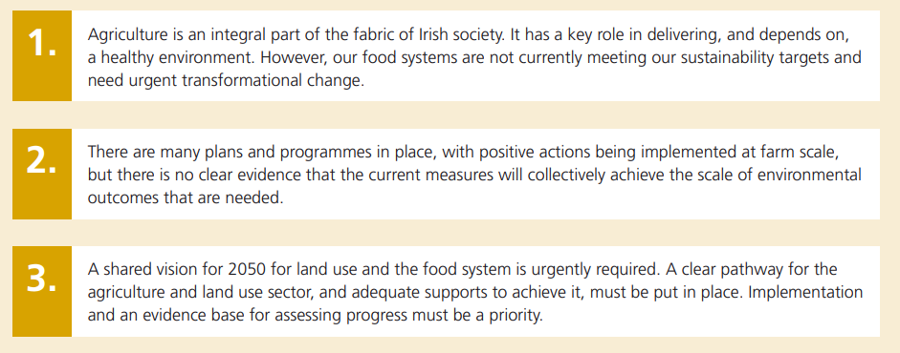
A changing country

Slide 39
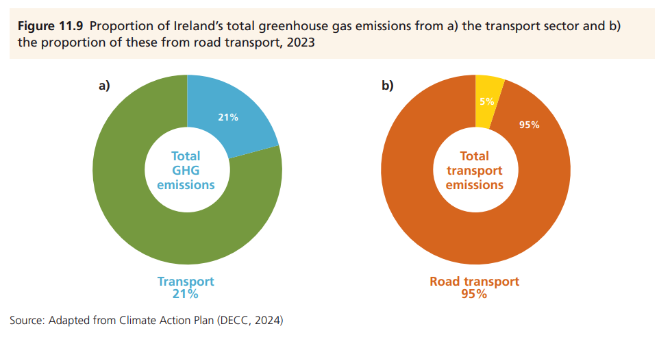
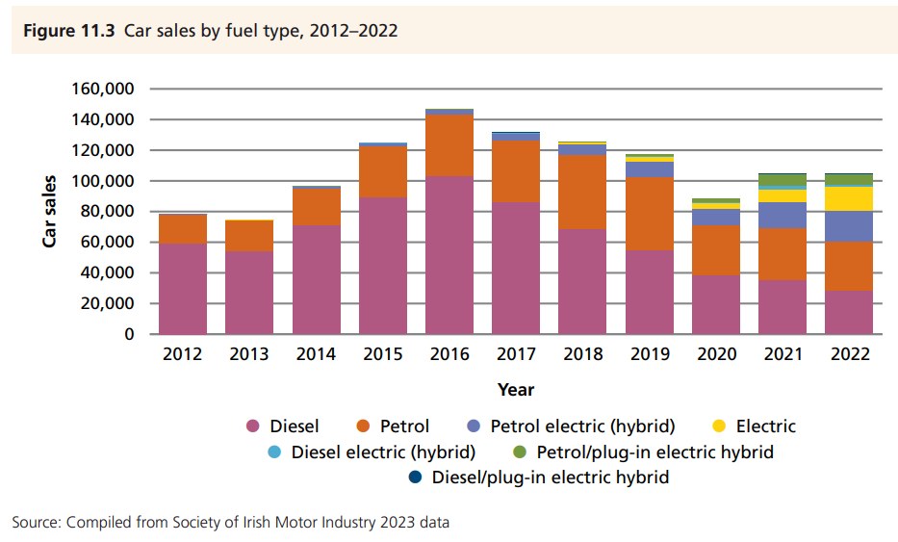

Slide 40
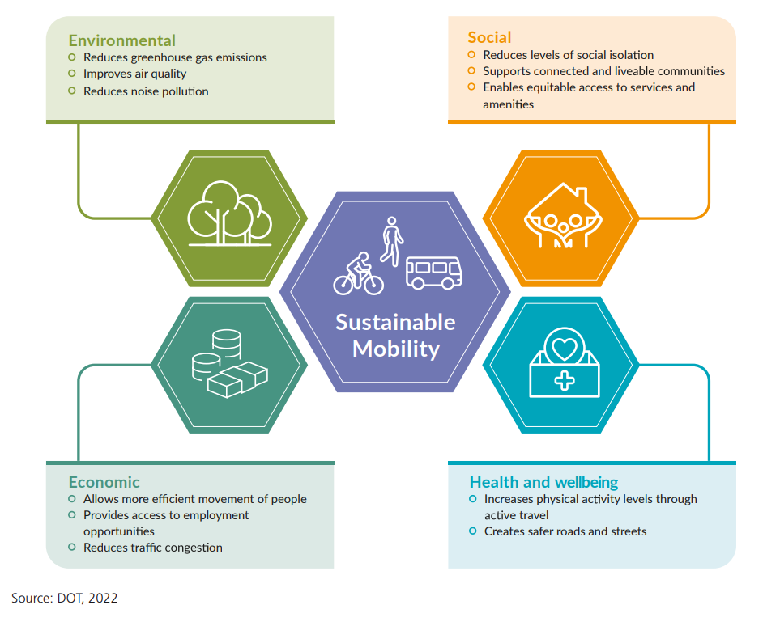

Slide 41
Climate Action Plan
National Sustainable Mobility Policy
Moving Together: A Strategic Approach to the Improved Efficiency of the Transport System in Ireland
Dublin, Cork, Galway, Limerick and Waterford Metropolitan Area Transport Strategies
National Investment Framework for Transport in Ireland
Renewable Transport Fuel Policy 2023–2025
National Road EV Charging Network Plan

Slide 42
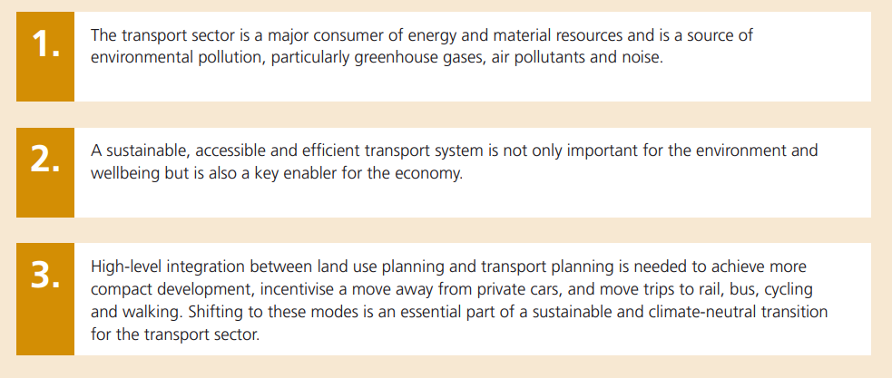

Slide 43
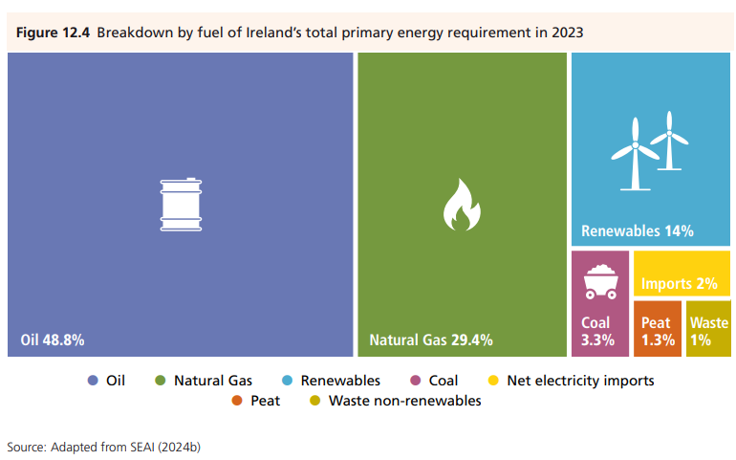

Slide 44
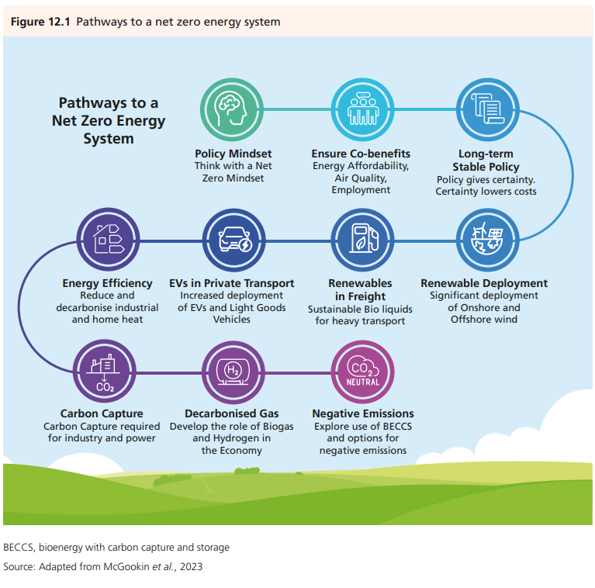

Slide 45
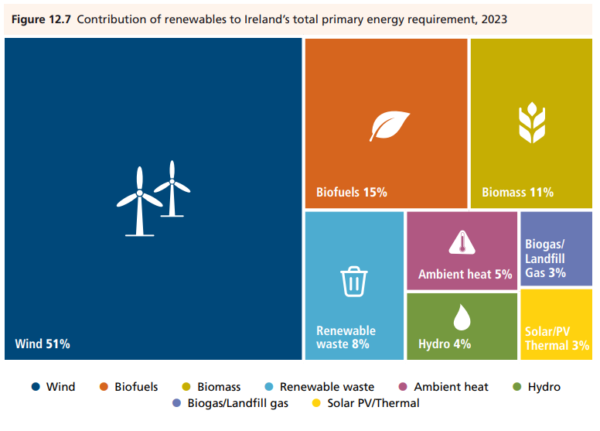

Slide 46
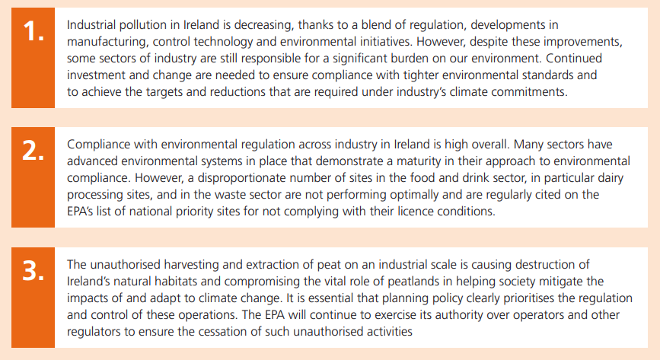

Slide 57
UN Agenda for Sustainable Development enhance policy coherence as an essential means of implementation of all the SDGs
Synergies: “climate change and biodiversity loss” and trade offs
Guide implementation
Ambitious Vision for Ireland’s Environment,
Climate Action and Low Carbon Development (Amendment) Act 2021: transition to a climate-resilient, biodiversity-rich, environmentally sustainable and climate-neutral economy by 2050

Slide 58
Legal Commitments: e.g
Urban Waste Water Treatment Directive
Water Framework Directive
European Climate Law (EU 2021/1119).
National Emissions Reduction Commitments Directive
Enforcement of environmental laws by all authorities

Slide 59
European Environment Agency: Environmental and sustainability challenges ….are inextricably linked to economic activities and lifestyles
Shift our society on to a sustainable trajectory
Energy System
Food System
Transport System
Industry

Slide 60
Population: 6.5 - 7 million by 2057
Waste Water Treatment
Resilience and Safe Water Supplies
National Electricity Grid
Renewable Electricity Generation
Light rail
Repair, reuse and remanufacturing facilities

Slide 61
Positive impact of engaging with Nature:
Better mental health and wellbeing,
physical activity,
stress reduction and social interactions.
Modifiable Harmful Exposures
Air: PM, Radon, NO2
Noise
Chemicals
Microbial/AMR

Slide 62
Title Page Options

